Slide 1
Mapping for Research and Policy
Week 7, Day 1

Slide 2
Where are we?
Introduction to Crime Analysis
Environmental Theories of Crime
Crime Analysis Process and Data
Introduction to ArcGIS Software Package
Building Base Maps & Selecting Symbols
Geocoding
Mapping for Research & Policy
Choropleths and Hot Spot Maps
MIDTERM EXAM – March 7
SPRING BREAK

Slide 3
Last week we…
Learned the definition of “geocoding.”
Learned that we can add data to our map using XY coordinates or using street addresses.
Learned how to build an address locator.
Added crime data and person data (RSOs) to our maps of Boston.

Slide 4
This week we will…
Learn about one application for mapping skills: policy planning and evaluation.
Learn how to draw buffers around features on our map.
Learn how to select features from our map using attributes and location.
Learn how to generate a report on some of the features on our map.

Slide 5
MAPPING FOR POLICY?

Slide 6
What was the research question?

Slide 7
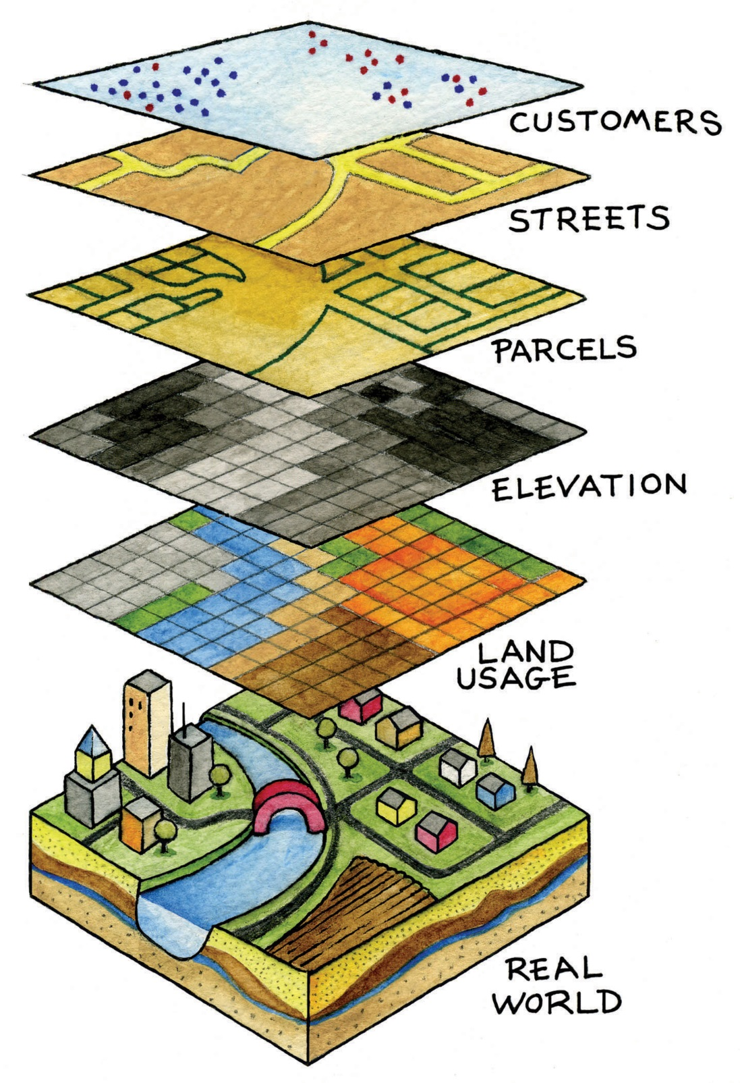
What sort of data did the researchers need for this analysis?
Where did they get it?

Slide 8
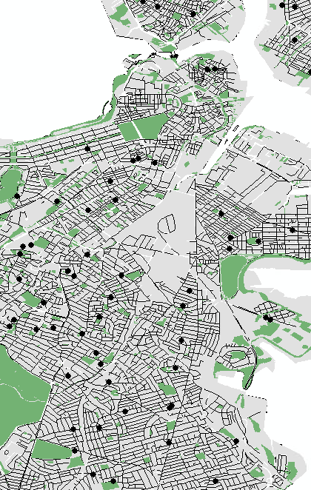
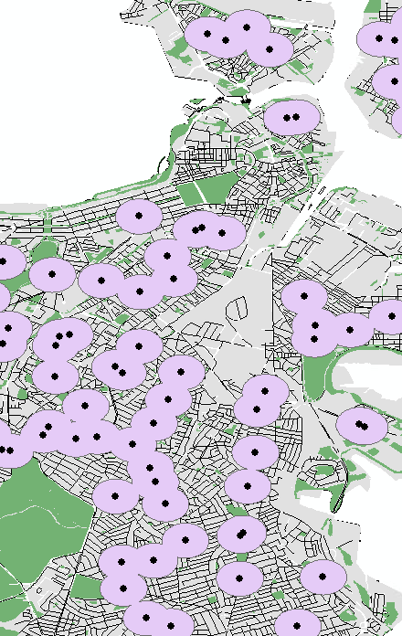
How did the researchers draw
the “exclusionary zones”?

Slide 9
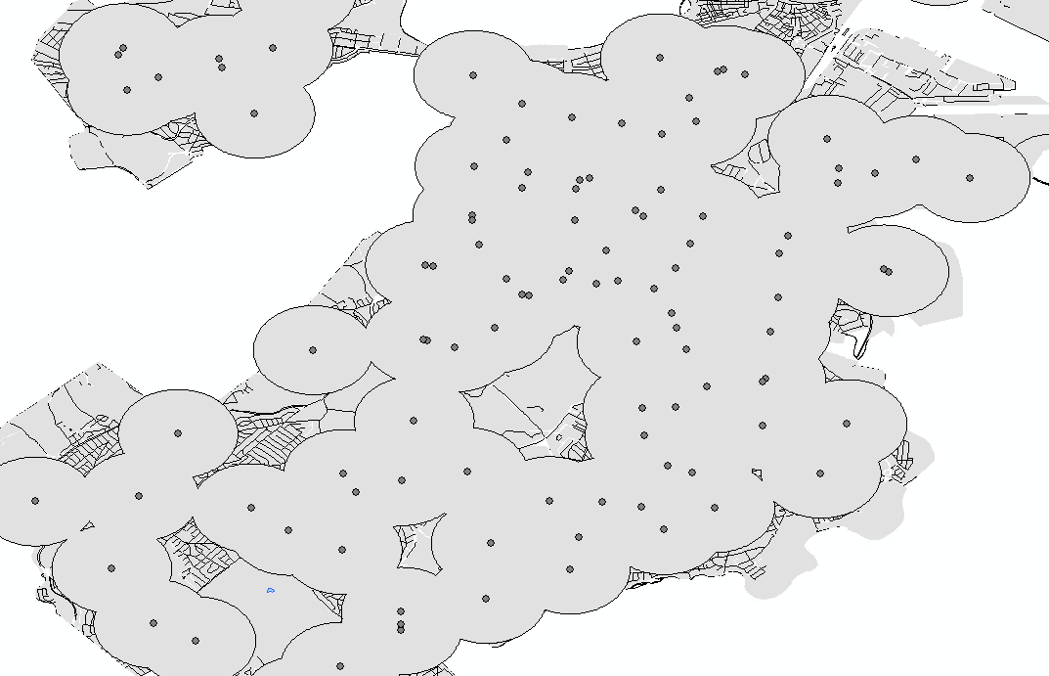
What did the researchers find?

Slide 10
If we wanted to replicate this study…
Where would we get base map files?
What data layers would we need on our map?
Do we have all the necessary mapping skills?

Slide 11
On Thursday, we will…
Add our Level 2 & 3 sex offenders to our base map.
Add our public schools layer.
Draw 1000ft and 2500ft buffers around the public schools.
Use “Select by Location” to identify how many registered sex offenders would be impacted if Boston passed a residency restriction law.

Slide 12
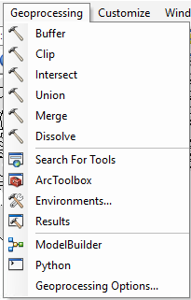
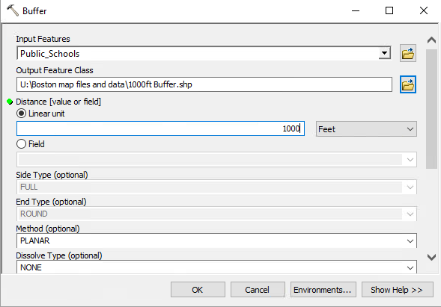
Drawing buffers is easy!

Slide 13
Drawing buffers is easy!

Slide 14
Drawing buffers is easy!
You can draw a buffer around any point, line, or polygon feature!

Slide 15
Drawing buffers is easy!

Slide 16
Drawing buffers is easy!

Slide 17
Drawing buffers is easy!

Slide 18
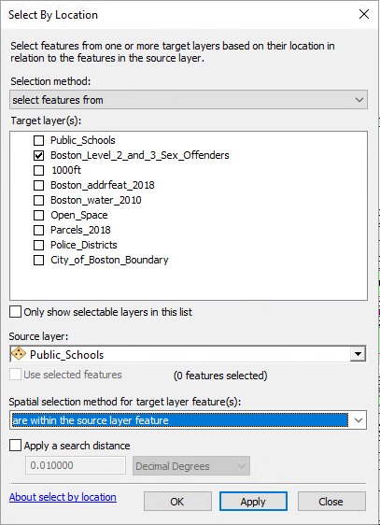
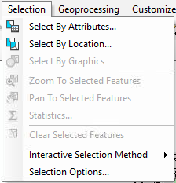
You know how to select by location…

Slide 19
What other research questions could you answer using your data and your skills?

