Slide 1
Geocoding
Week 6, Day 1

Slide 2
AGENDA
What is geocoding?
Data cleaning before geocoding
Geocoding options: XY Coordinates
Geocoding options: Addresses and address locators
Reviewing and rematching addresses

Slide 3
What is geocoding?
Geocoding: providing geographical coordinates corresponding to a location.
e.g. “Where is 73 Tremont St located on the Earth’s surface?”
Reverse geocoding: converting geographic coordinates to a description of a location.
e.g. “What is the street address for the XY coordinates 42.354831914, -71.056333108?”

Slide 4
Geocoding process - ideal
Get list of addresses
Build address locator
Use address locator to geocode 100% of addresses to map

Slide 5
Geocoding process - real
Get list of addresses
Build address locator
Try to geocode addresses. Address locator doesn’t work.
Rebuild address locator one million times.
Settle for some less-than-100% matched addresses.
Rematch addresses ad nauseum.
Address locator working. Geocode address. Only 60% match.

Slide 6
Geocoding process - real
Get list of addresses
Build address locator
Try to geocode addresses. Address locator doesn’t work.
Rebuild address locator one million times.
Settle for some less-than-100% matched addresses.
Rematch addresses ad nauseum.
Address locator working. Geocode address. Only 60% match.

Slide 7
Remember:
in,
out.
This is never more true than when trying to geocode addresses!

Slide 8
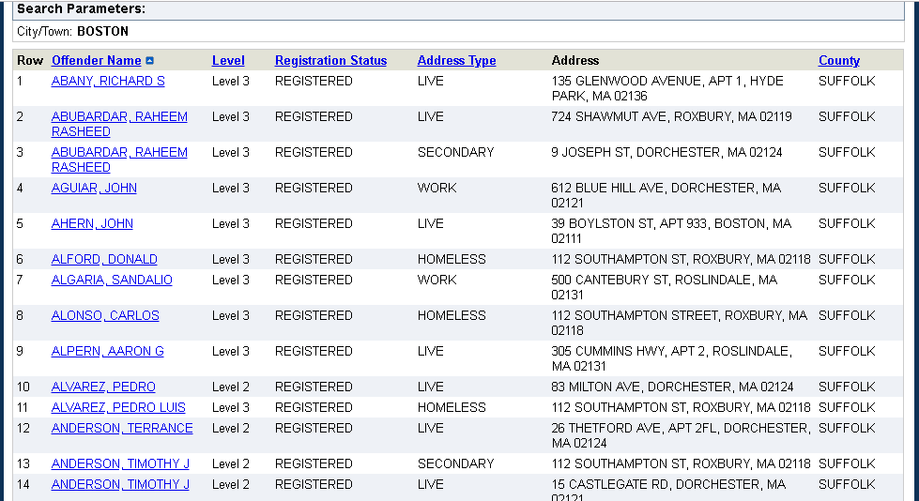
Example: Sex Offender Registry Data

Slide 10
Many people who are homeless – no mappable address

Slide 11
Boston zip codes begin with 0, but Excel is reading as a number and deleting it.

Slide 12
Some addresses might be outside of City of Boston – won’t show up on our map.

Slide 13
To fix Boston zip codes:
Create a new column in the Excel file.
In the top cell, type =CONCAT(0, [zip])
Replace [zip] with the cell number of the first cell with a zip code in it.
See example on next slide >>>

Slide 14
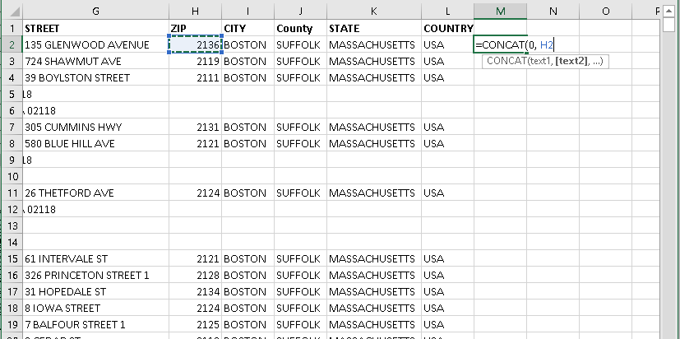

Slide 15
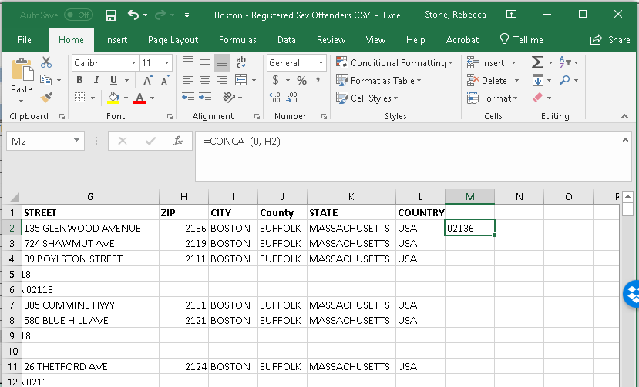
Click the bottom-right corner of the new zip code cell you created and drag it down to apply this formula to all cells in this column. Give your new column a title like “NEWZIP”. Right-click the column header and format the cells as ‘Text’ so that 0 doesn’t disappear again!

Slide 16
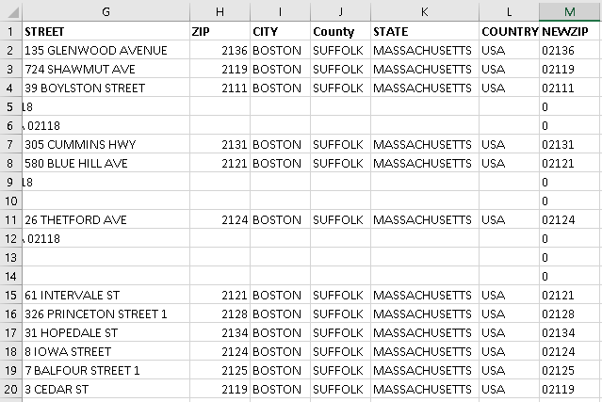

Slide 17
What about the rest of our data?
We fixed the zip code issue, but we still have hundreds of unmappable addresses.
Some are truly unmappable – just “BOSTON, MA.” Others do have a full address, but not a neatly-formatted street address. There are lots of repeat addresses!
Try Googling 112 Southampton St, Roxbury or 444 Harrison Ave, Boston.
What did you find?

Slide 18
Now what?
It depends on what we want to do with our analysis.
Do we want to geocode as many SOs as possible, even if they are living in shelters?
Do we only care about residential addresses?
We can’t do anything with the SOs with no address at all.

Slide 19
For now…
Let’s save a copy of our spreadsheet so we don’t overwrite any original data. We can always go back to the original if we mess up our copy. Save as Boston – RSOs – Clean.csv
In our copied spreadsheet, delete all of the SOs with “Address not mappable.” (Try sorting the FULLADD column alphabetically first, to group them all together).
For FULLADD addresses that appear to be shelters, put the address details into the STREET, CITY, and NEWZIP columns.

Slide 20
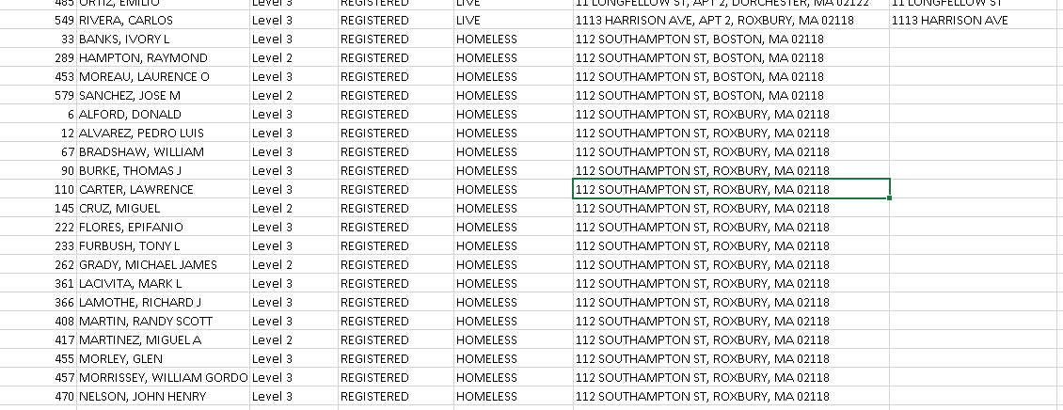
Are these different addresses in Boston and Roxbury,
or the same place but error in data entry?

Slide 21
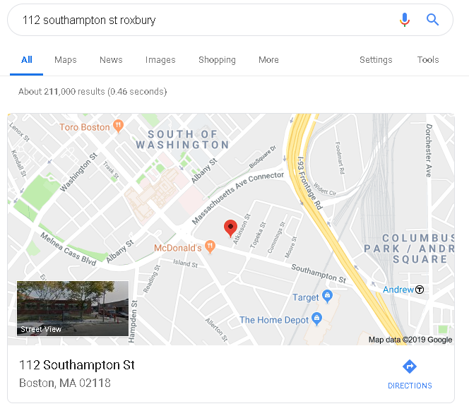
Probably the same place. Looks like it is really Boston.

Slide 22
Cleaning, cleaning, cleaning…
You should end up with a “clean” data set that has valid information for most cases.
Some of these addresses may still not map, but we’ve done our best to maximize the usefulness of these data.
What’s next?

Slide 23
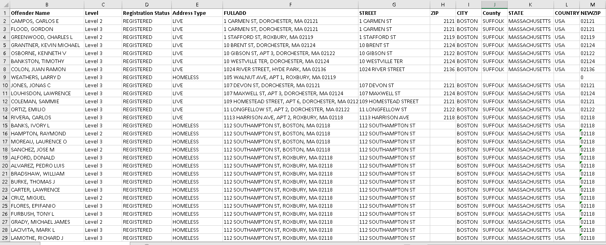

Slide 24
Getting the data on to your map
The easy way: Your data already have X, Y coordinates and it is just a matter of putting the table of data into ArcGIS and plotting it on the map.
The hard way: Your data only have street addresses, so we have to tell the program how to find a street address using some layer on our map.

Slide 25
The Easy Way: XY Coordinate Data

Slide 26
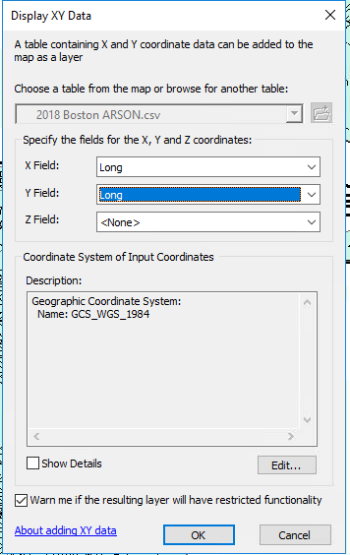
Drag and drop your CSV file into your Table of Contents.
Right-click and choose Display XY data…
Make sure the right fields are entered for X (longitude) and Y (latitude).
Set the Coordinate System to something that matches the most layers of your map (Click Edit, scroll down to the Layers folder, and choose a layer).
Click OK and bam! Done.

Slide 27
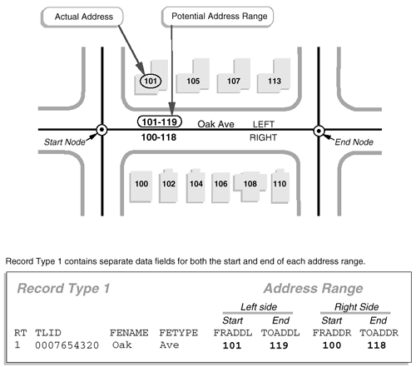
The Hard Way: Building an address locator
An address locator is a dataset that tells ArcGIS how to translate nonspatial descriptions of places (like street addresses) into spatial data (like XY coordinates).
TIGER files contain address ranges rather than individual addresses. The address range is the first to last possible address number along a block face. Addresses may also be on the left or right side.

Slide 28
The Hard Way: Building an address locator
To geocode a dataset of street addresses onto a map, we have to build the dataset that tells ArcGIS where those addresses are located.
Enter: the address locator!
One way to build address locators is to use the Address Range-Feature (ADDRFEAT) file from the Census/TIGER.

Slide 29
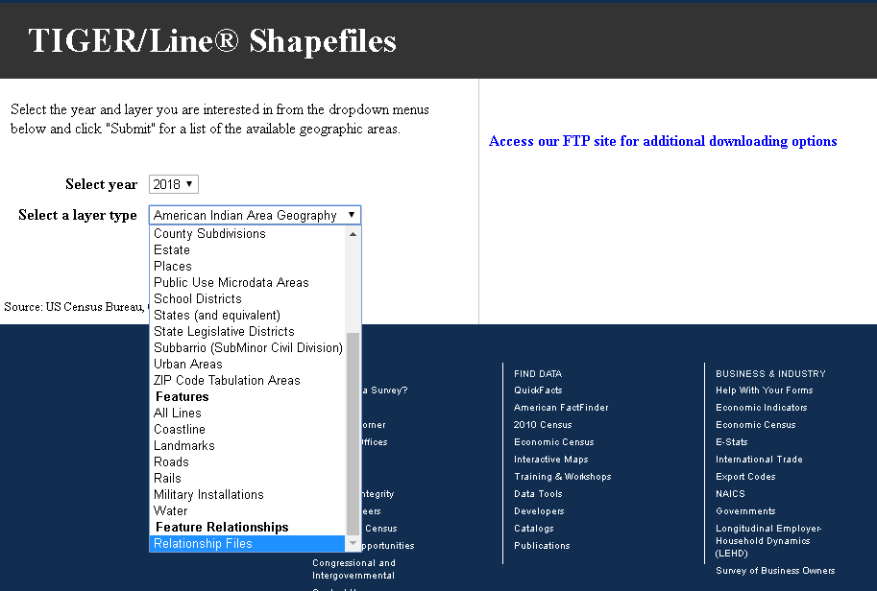

Slide 30
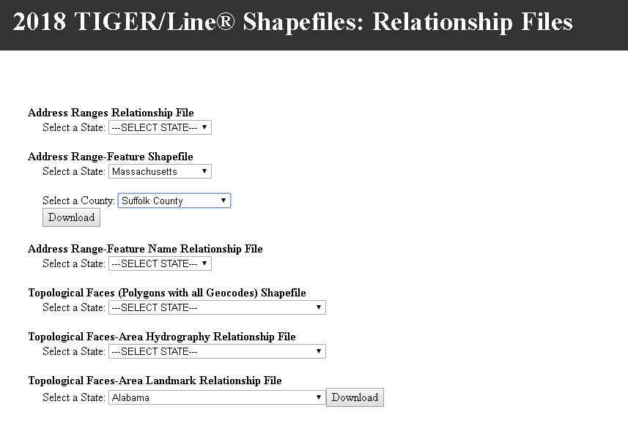

Slide 31
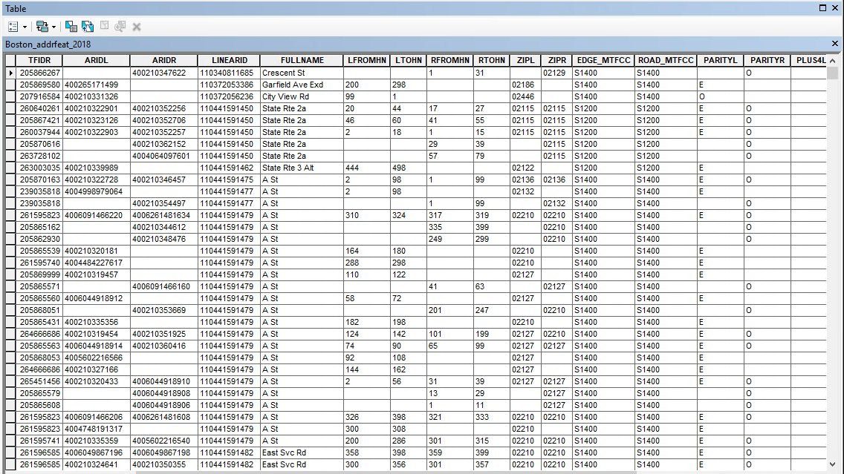

Slide 33
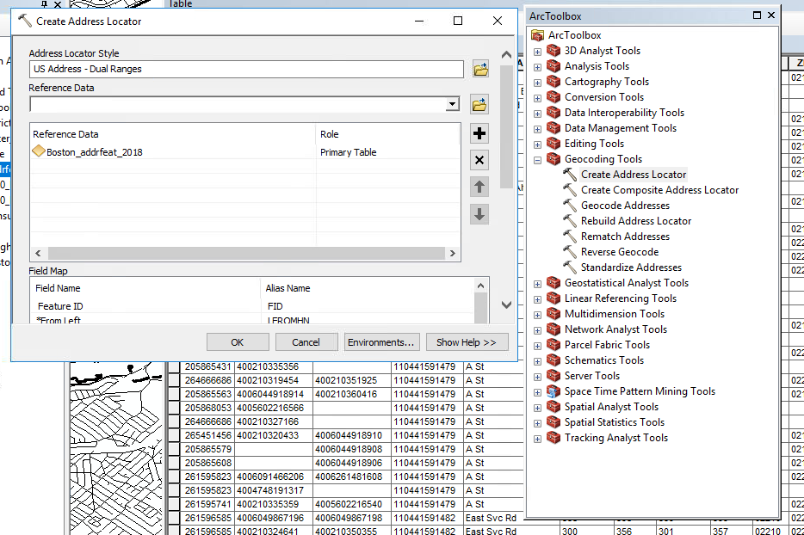

Slide 34
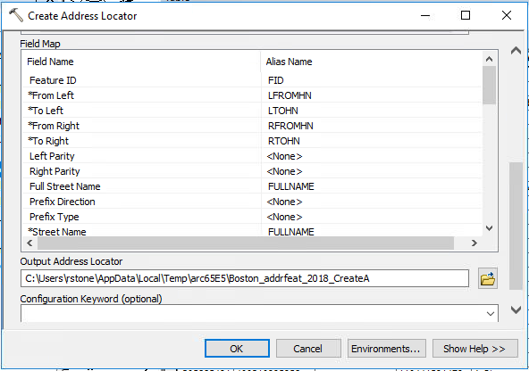
We are telling the program where to find the information it needs in our ADDRFEAT layer’s attribute table.
e.g. it needs to know which column has the Street Name, so we tell it to look in the column titled FULLNAME.

Slide 35
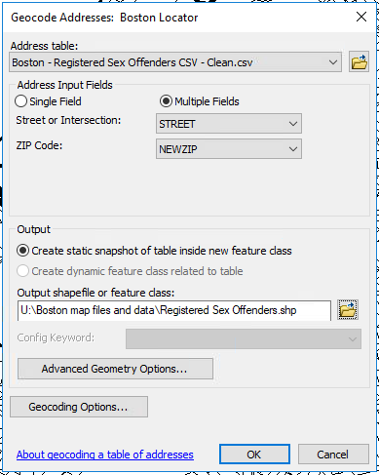
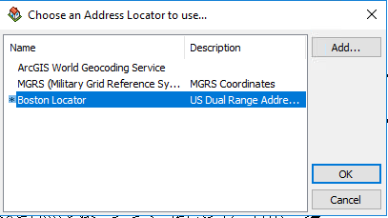
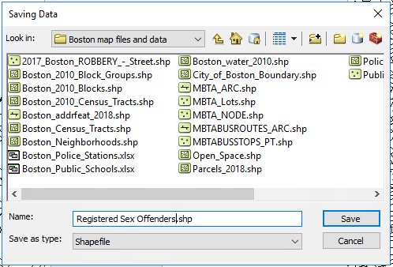

Slide 36
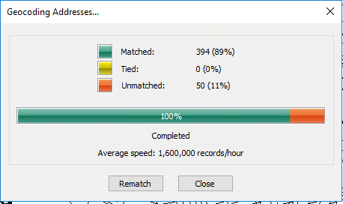
That’s… pretty damn good for a first run!
Imagine if we hadn’t cleaned that data first.

Slide 37
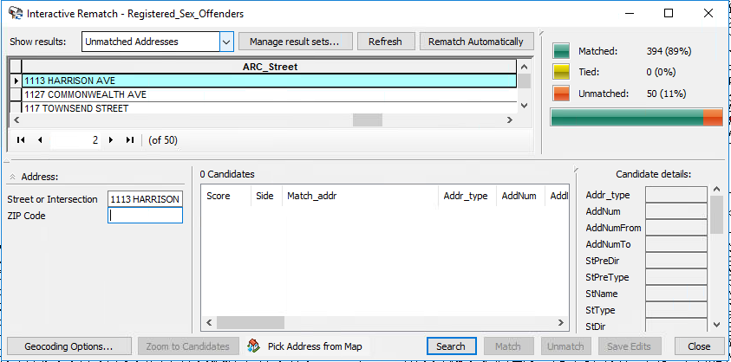
Let the detective work begin: resolving unmatched addresses by hand.

Slide 38
Just
It.

Slide 39
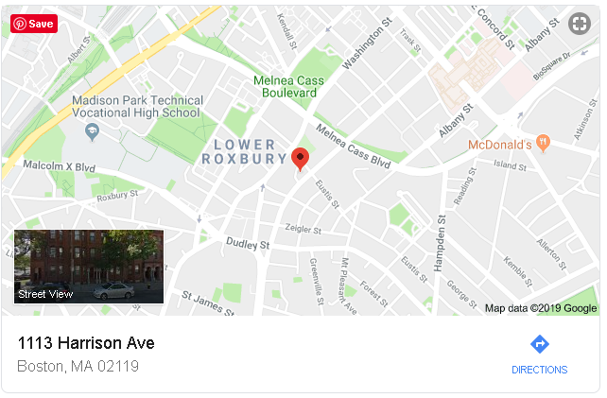
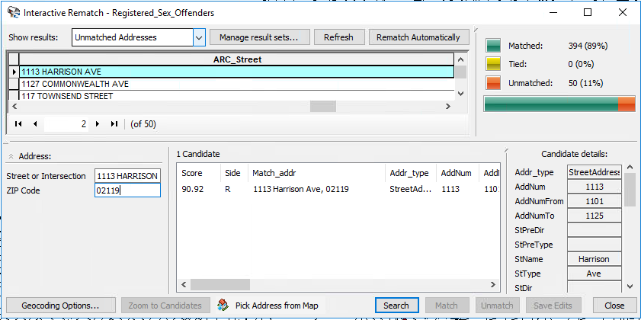

Slide 40
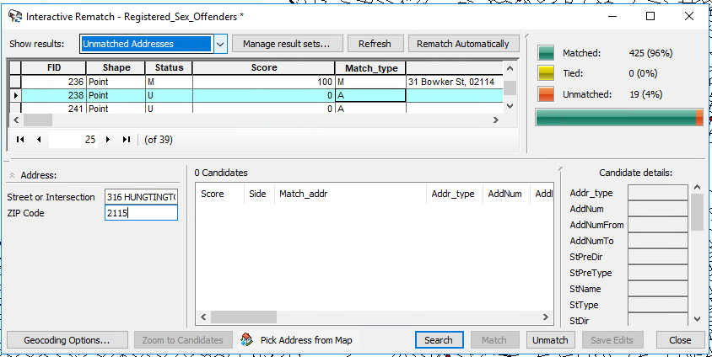
Probably
“Huntington”

Slide 41
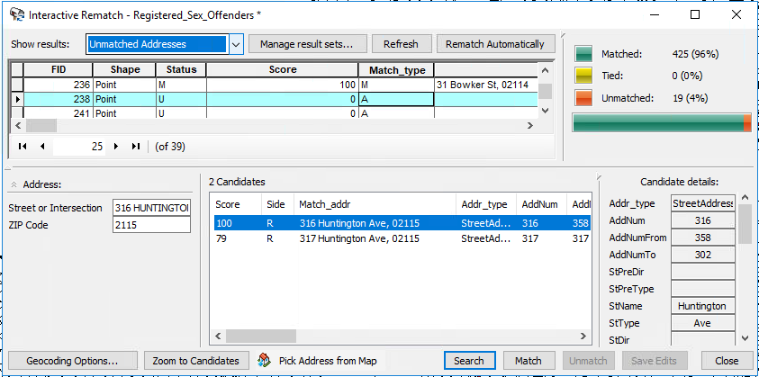
Yep.

Slide 42
Eventually…
98% matched.
Is that enough?
Turns out there is no hard rule about what percentage of addresses you must correctly match – but of course more is better, and too few is certainly misleading.
Remember: this still isn’t 98% of all RSOs. What about the people we left out in the beginning?

Slide 43
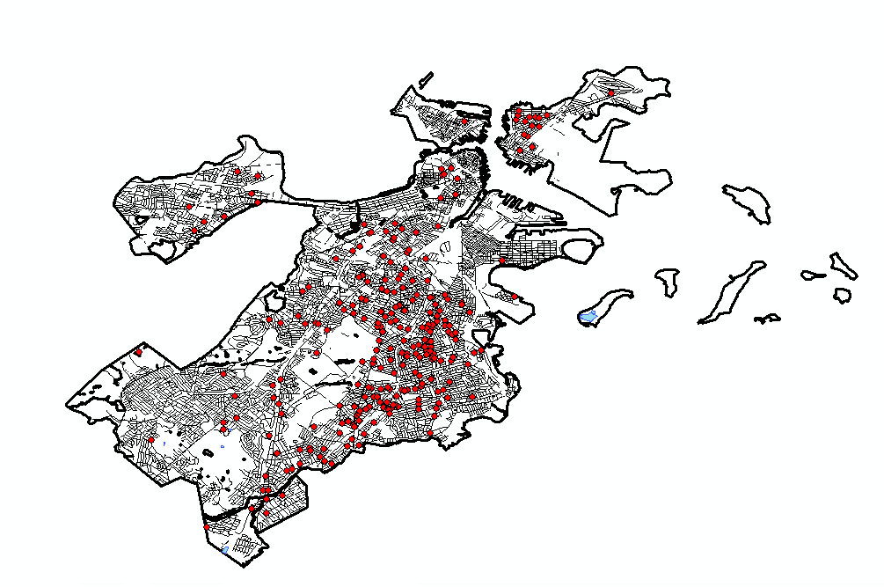

Slide 44
Next class…
Adding the ADDRFEAT layer to your map of Boston (should be there from ArcGIS #1, but just in case…)
Building your own Boston address locator.
Adding RSOs to your Boston map by geocoding addresses and rematching (ArcGIS #2; necessary step before ArcGIS #3).
Adding crime data to your map with X,Y coordinates.

