Slide 1
Points, Lines, and Polygons: Cartography Basics
Week 5, Day 2

Slide 2
Mapping is Data Visualization
What is the advantage of visualizing our data?

Slide 3
Visual Thinking and Communication
Maps help with visual thinking by helping us make connections between different phenomena (e.g. land use and crime) or to see patterns in similar types of crime.
Vertical
Connections between different phenomena
Horizontal
Common factors across particular crime types

Slide 4
Visual Thinking and Communication
Maps help with visual communication by allowing us to synthesize and present the results of our analysis because they allow our brains to process large amounts of complex data more easily than spreadsheets or reports.
Vertical
Connections between different phenomena
Horizontal
Common factors across particular crime types

Slide 5
Mapping is a Science and an Art!
Maps show the results of science – data collection, analysis, and interpretation.
There is science behind how we interpret visualizations, e.g. how we usually interpret hue, brightness, and saturation, or how clutter detracts from interpretation.
But there is also art in creating beautiful and effective mapping products.

Slide 6
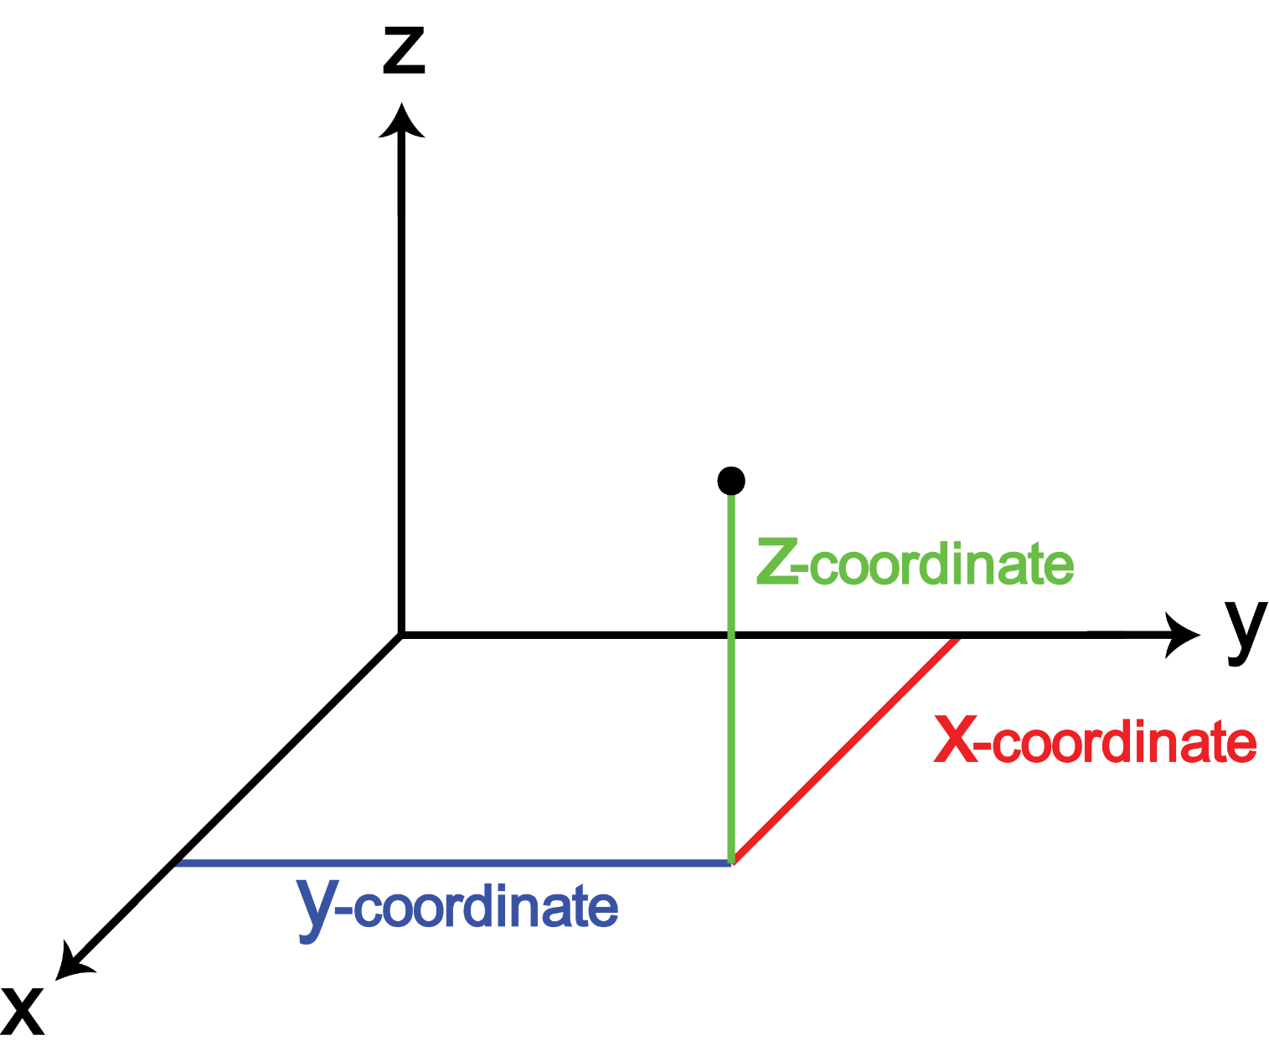
Map Features
Features are represented by vector data. Vector shapes are represented using geometry made up of one or more interconnected vertices – a position in space described on the X, Y, and sometimes Z axis.

Slide 7
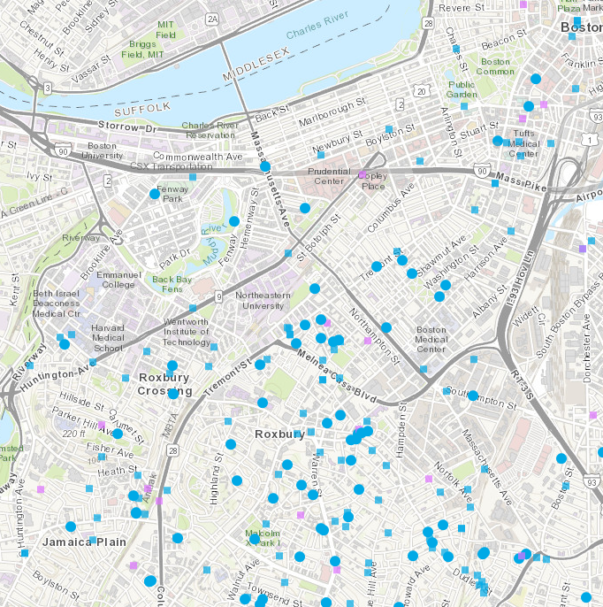
Map Features: Points
When a feature’s geometry consists of only a single vertex, it is a point feature.
A single X, Y location is a point.
Points are good for marking the location of incidents or single things – e.g. a person, a fire hydrant.

Slide 8
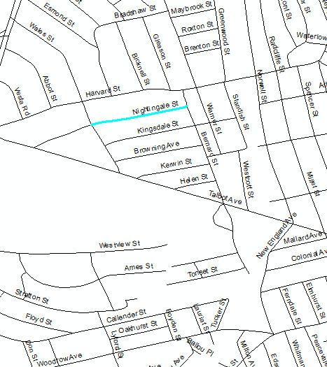
Map Features: Lines
When a feature’s geometry consists of two or more vertices and the first and last vertex are not equal (in the same place), a line is formed.
Lines are good for representing roads and other transportation features. Sometimes they represent small waterways.

Slide 9
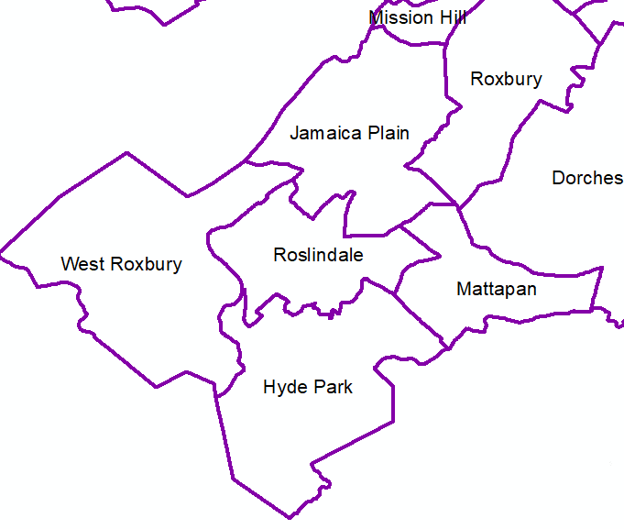
Map Features: Polygons
When a feature’s geometry consists of three or more vertices and the first and last vertex ARE equal (in the same place), an enclosed polygon is formed.
Polygons are used to represent areas – like city blocks, buildings, parks, census tracts, or entire states and countries.

Slide 10
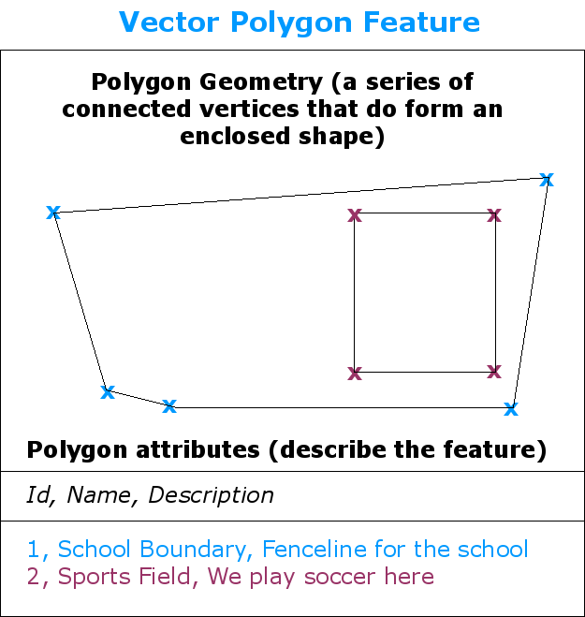
Source: https://docs.qgis.org/2.8/en/docs/gentle_gis_introduction/vector_data.html

Slide 11
Choosing Colors
When you add layers to your map, they will usually be drawn with random colors and symbols.
This is usually REALLY ugly.
You should change the colors and symbols so that your map is easy for people to interpret (and is also visually pleasing!).

Slide 12
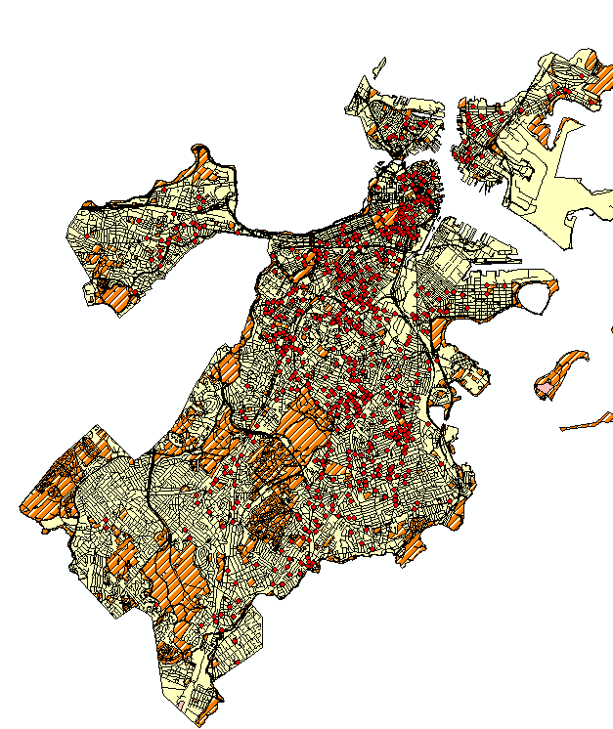
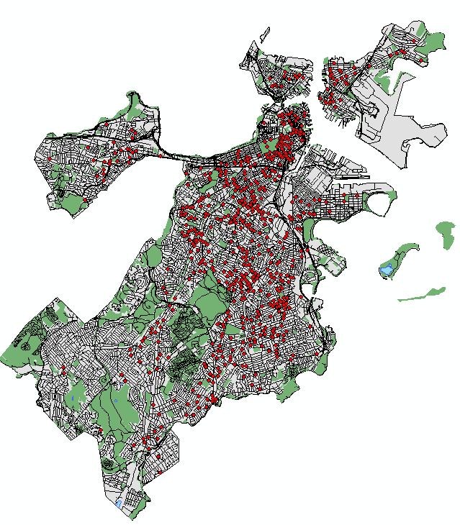

Slide 13
Different hues in the same lightness and saturation should be used for nominal data (unorderable categories).

Slide 14
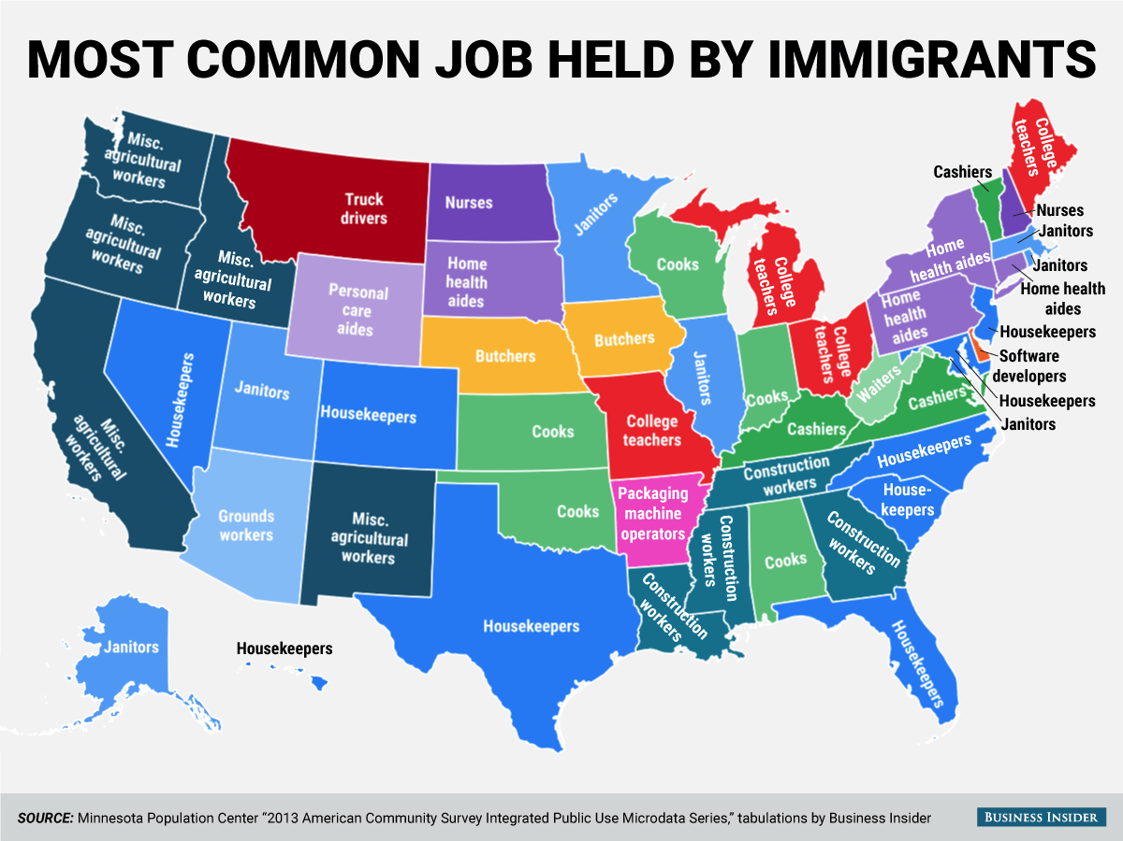

Slide 15
The same hue in increasing darkness or saturation can be used with orderable (rankable) categories or numerical data.
Darker or more saturated means higher, greater, stronger.

Slide 16
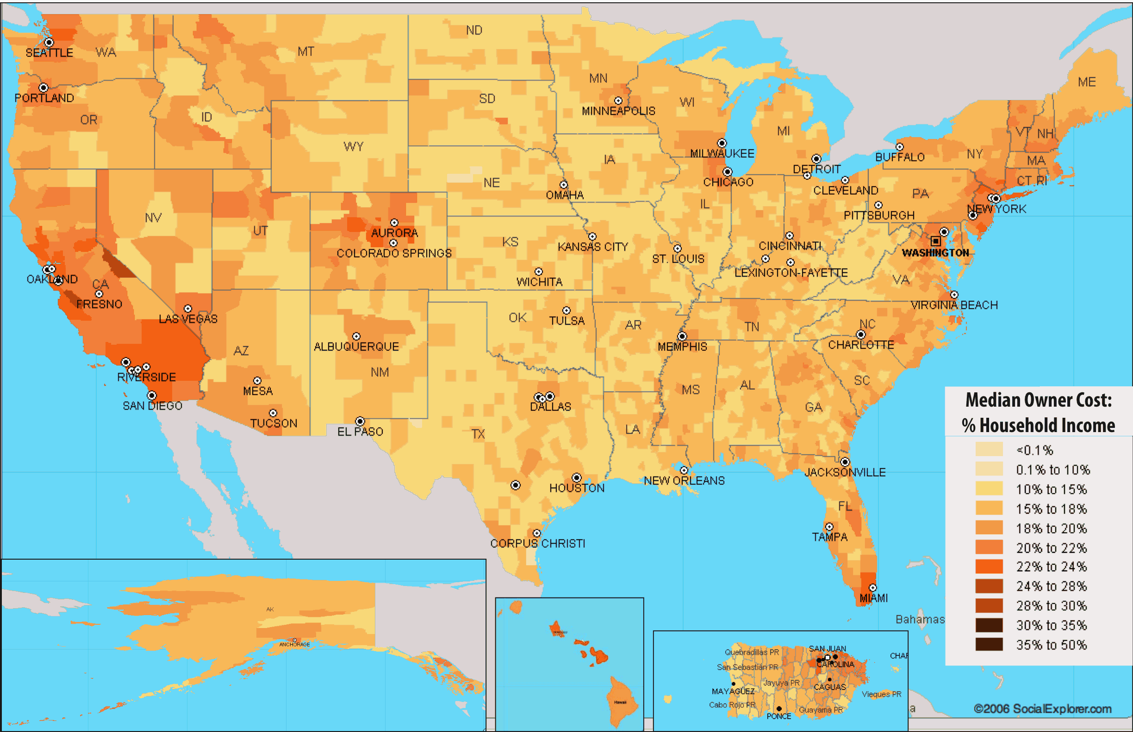

Slide 17
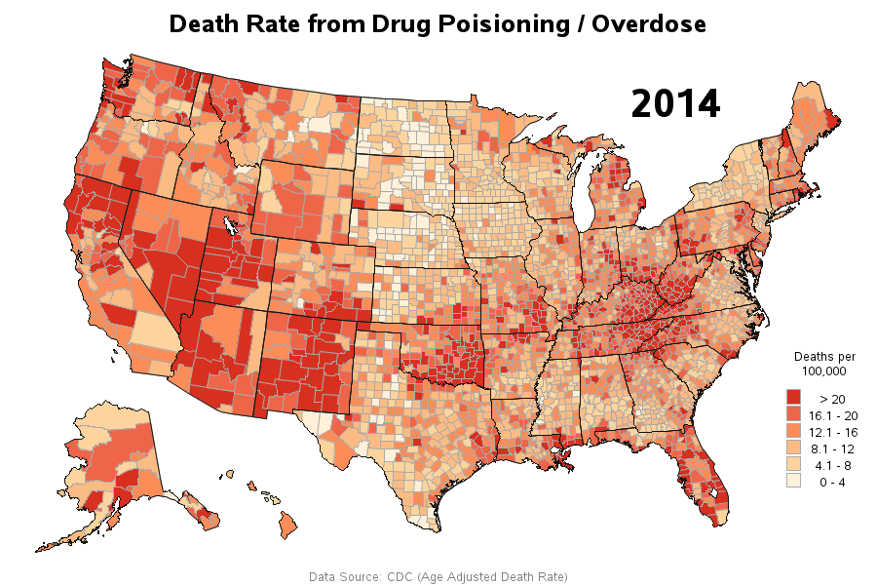

Slide 18
A diverging color scheme can be used with numerical data that can be divided meaningfully at a midpoint (e.g. average, zero).
Darker or more saturated means larger, greater, stronger.

Slide 19
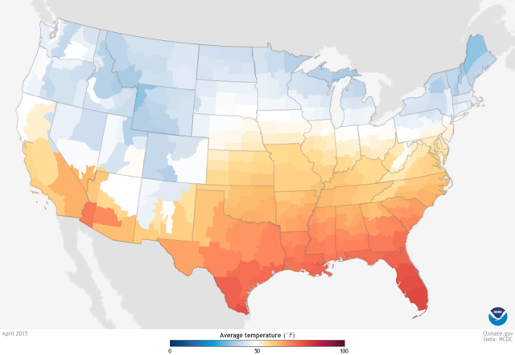

Slide 20
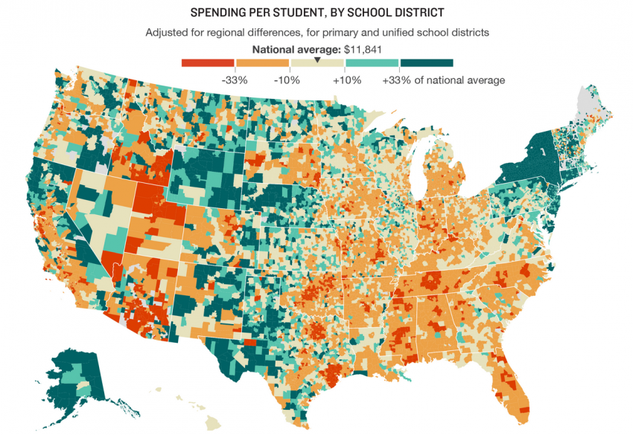

Slide 21
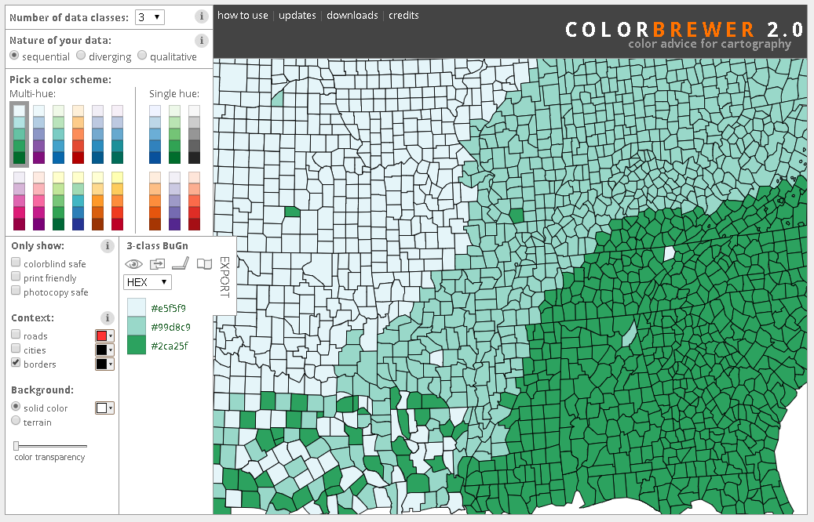
Online tools can help you choose good color schemes.
[click] to visit ColorBrewer2.org

Slide 22
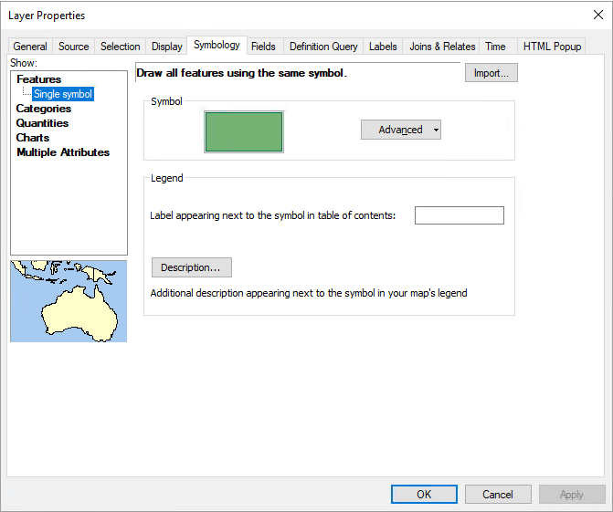
The Symbology Menu
Right-click layer
Properties
Symbology
Single Symbol: One way of symbolizing all features of this layer – e.g. all one color, all one icon.

Slide 23
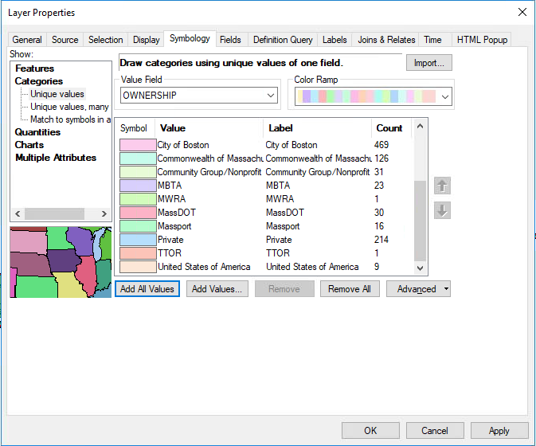
The Symbology Menu
Categories: Symbolize the features in this layer in different ways according to the value of some category in the attribute table.
e.g. for Open Space layer, different colors for different ownership.

Slide 24
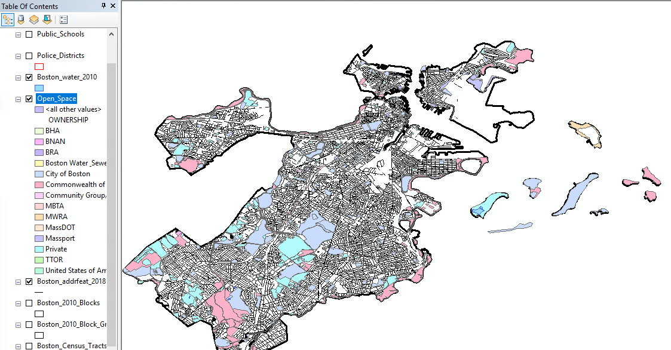

Slide 25
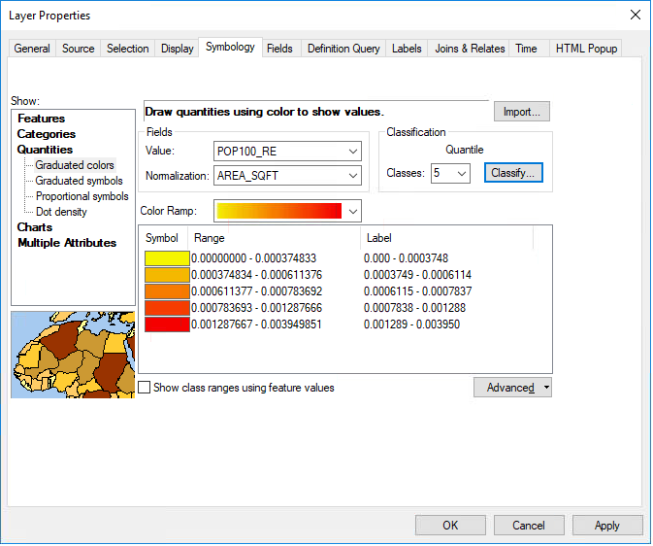
The Symbology Menu
Quantities: Symbolize the features in this layer in different ways according to the value of some numerical variable in the attribute table.
e.g. for Census Tracts layer, shading tracts by population.
Remember to normalize if necessary.

Slide 26
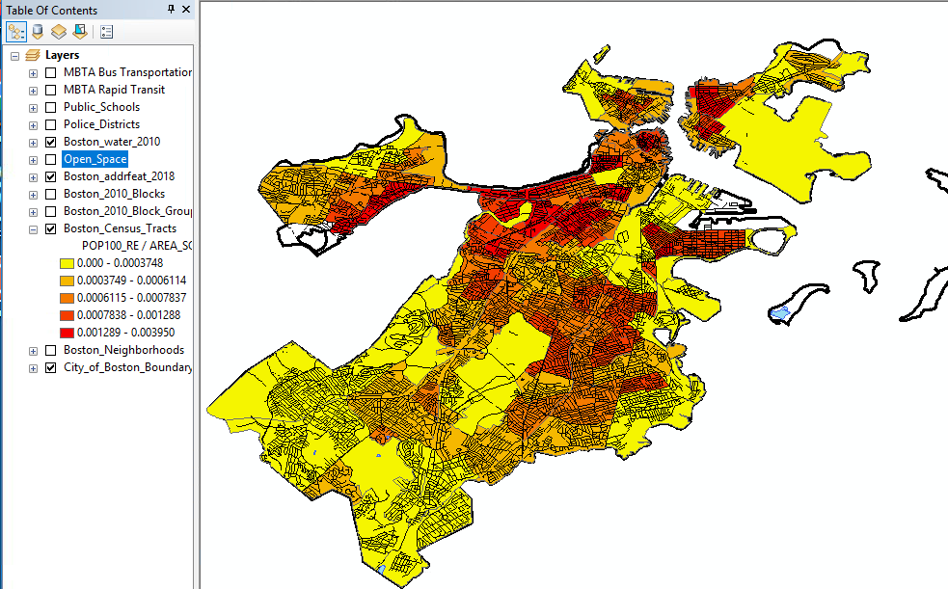

Slide 27
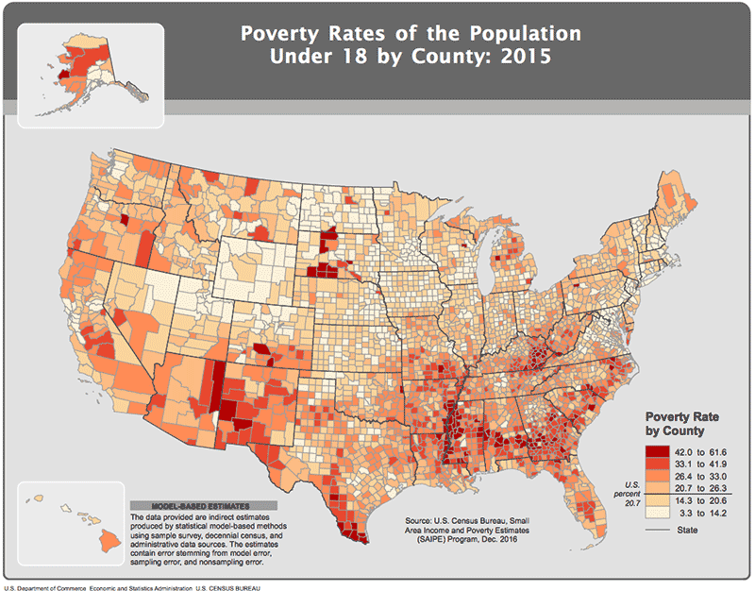
Required Map Elements
Titles
Legends or Keys
Scale
North Arrow or Compass
Data Source
Author and Date
Projection System

Slide 28
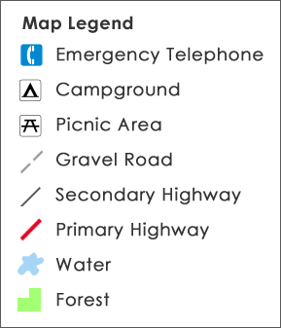
Required Map Elements
Titles
Legends or Keys
Scale
North Arrow or Compass
Data Source
Author and Date
Projection System

Slide 29
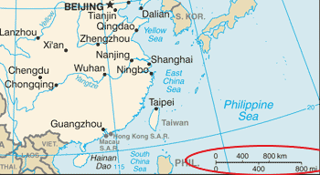
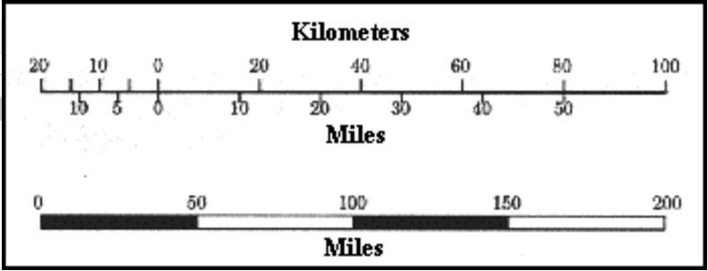
Required Map Elements
Titles
Legends or Keys
Scale
North Arrow or Compass
Data Source
Author and Date
Projection System

Slide 30
Required Map Elements
Titles
Legends or Keys
Scale
North Arrow or Compass
Data Source
Author and Date
Projection System

Slide 31
Required Map Elements
Titles
Legends or Keys
Scale
North Arrow or Compass
Data Source
Author and Date
Projection System

