Slide 1
The Past and Present of Crime Mapping
Week 4, Day 1

Slide 2
AGENDA
Reminders – bring USBs, final projects
History of Crime Mapping
Crime Mapping today – GIS
Projections and Coordinate Systems
Traditional Elements of Maps
What are “Thematic Maps”?

Slide 3
The History of Crime Mapping

Slide 4
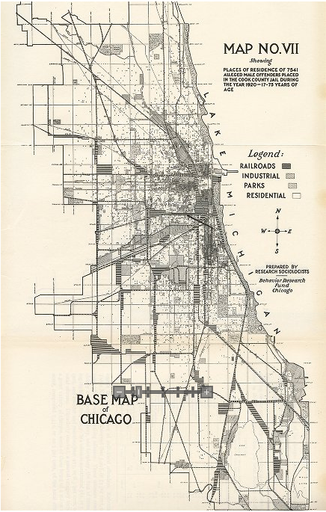
Shaw and McKay, sociologists from the “Chicago School” of sociology, mapped incidents of juvenile delinquency and other social conditions.
Others developed an urban model based on concentric zones in an attempt to explain the layout of cities.
Underlying assumption: Geographic variations in social conditions are related to patterns of crime.

Slide 5
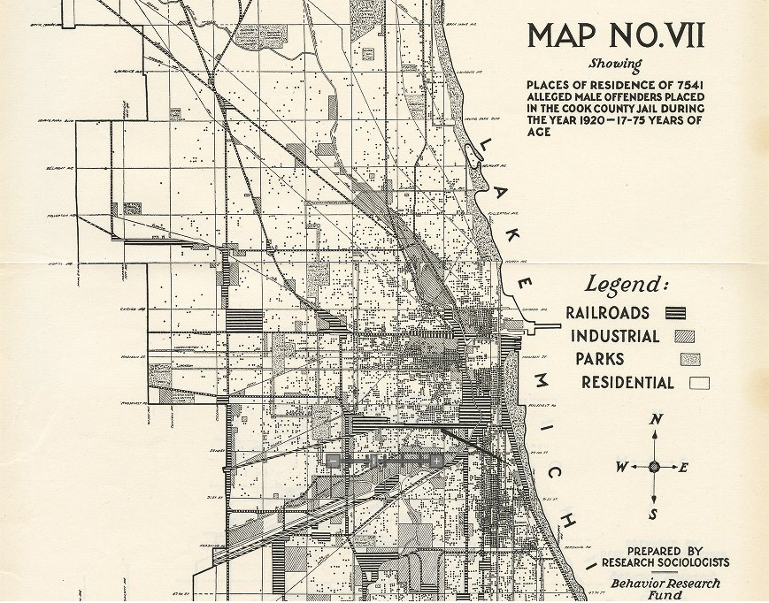

Slide 6
Title
Key or Legend
Compass
or North Arrow
Creator

Slide 7
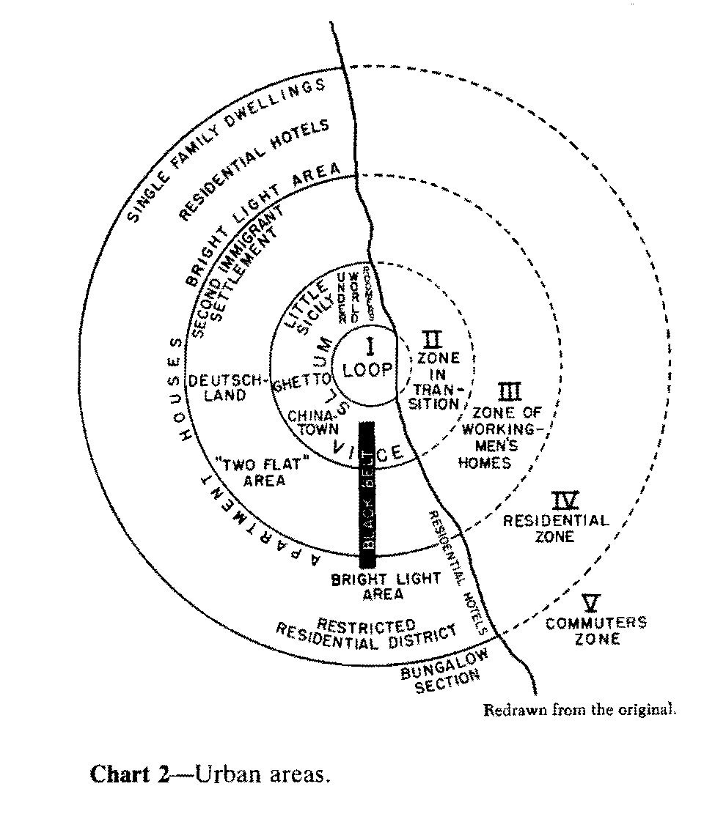
Park and Burgess (1925), “The Growth of the City”
Depicts urban land usage in concentric rings around the Central Business District (CBD)
Zone I: The CBD
Zone II: The Zone of Transition – mixed residential/commercial
Zone III: Working class residential homes
Zone IV: Middle-class residential zone
Zone V: Commuter zone

Slide 8
Criticisms:
Is somewhat specific to the US; cities don’t follow this pattern elsewhere.
Times have changed – now we have cars, highways, mass transportation systems.
Urban regeneration and gentrification mean previously low-income housing areas are now becoming more expensive.
Expensive urban real estate means many manufacturing industries have moved/are moving out of cities.
Reality is more complex than this!
Park and Burgess (1925), “The Growth of the City”
Depicts urban land usage in concentric rings around the Central Business District (CBD)
Zone I: The CBD
Zone II: The Zone of Transition – mixed residential/commercial
Zone III: Working class residential homes
Zone IV: Middle-class residential zone
Zone V: Commuter zone

Slide 9
Does the concentric zone model work for Boston? Why or why not?

Slide 10
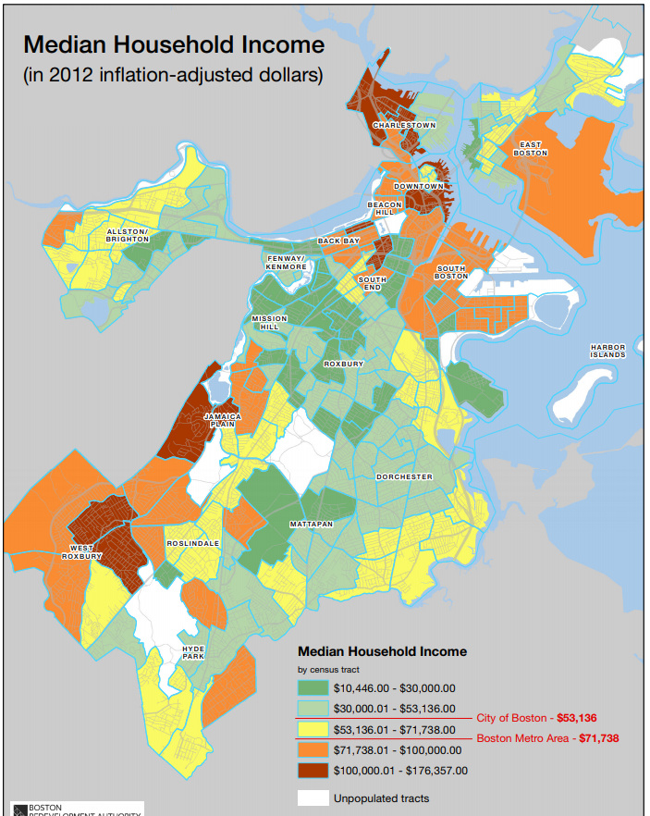
Zone I: The CBD. High density, lots of transportation networks.
Zone II: The Zone of Transition – lowest income, land use changing, residential deterioration.
Zone III: Working class residential homes. Better conditions than Zone II, lots of rental housing.
Zone IV: Middle-class residential zone. Bigger houses, detached houses, families. Parks and open spaces.
Zone V: Commuter zone. High income groups who can afford large houses and high commuting costs.
Zone I
Zone II
Zone III
Zone IV
Zone V

Slide 11
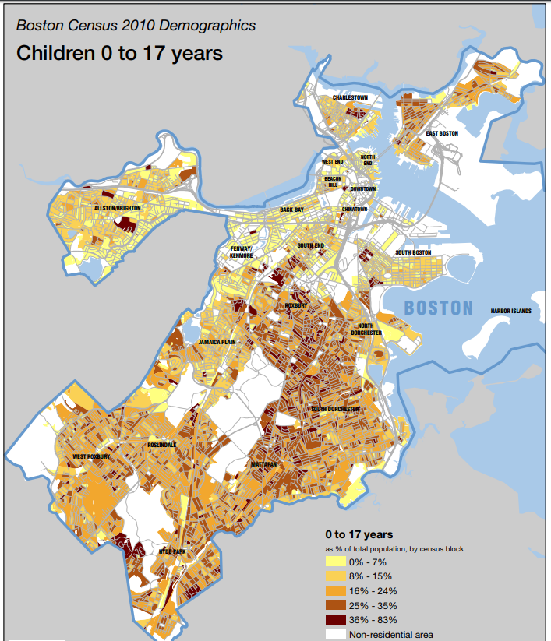
Zone I
Zone II
Zone III
Zone IV
Zone V

Slide 12
The History of Crime Mapping

Slide 13
Problems with Pin Maps
Tedious af
Can’t be saved as updated
Maps could not be manipulated or queried
Difficult to read
Took up tons of space (70 square feet?!)

Slide 14
Enter: Computer Mapping
First used in mid-1960s
Originally on huge mainframe computers using punch cards
Too labor intensive to be worth it
Mid-1980s, early 1990s: computer processing speed increases

Slide 15
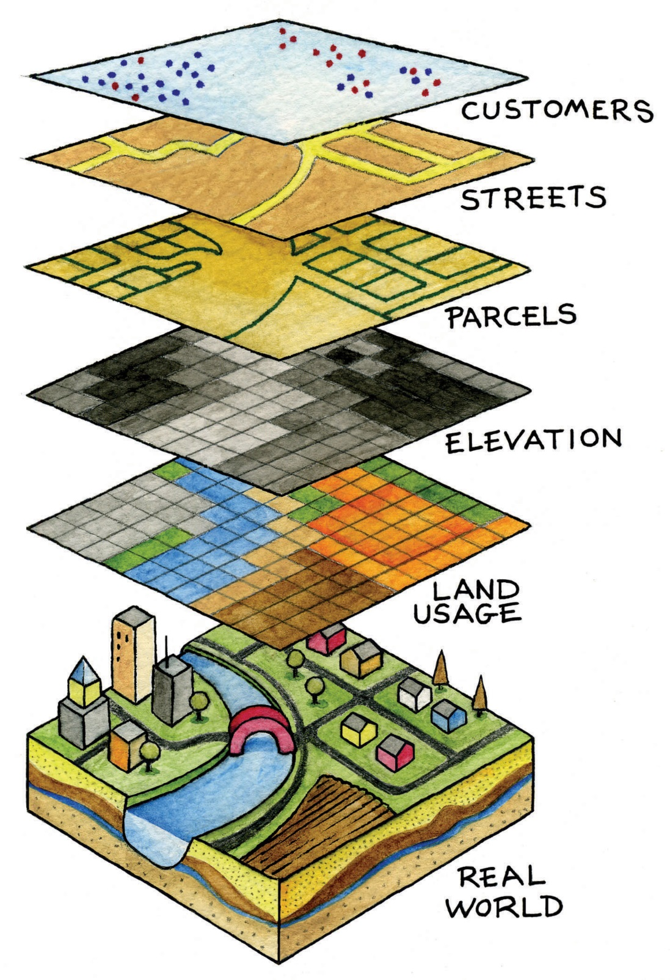
Geographic Information Systems (GIS)
A computerized mapping system that permits information layering to represent and analyze geographic information.
ArcGIS: a proprietary GIS software package
Layers are made up of tables of data underlying visual representations.

Slide 16
A GIS allows you to visualize your data as a map.

Slide 17
Representing Curved Surfaces

Slide 18
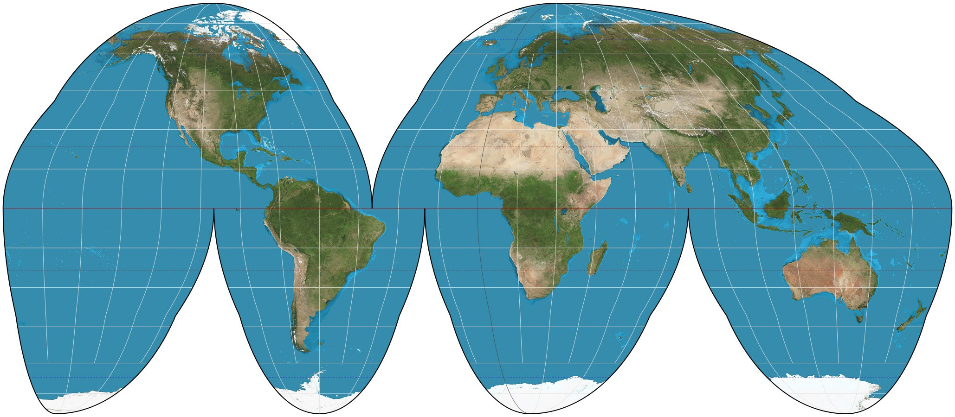
Projections determine how the latitude and longitude grid of the Earth is represented on flat paper.

Slide 19
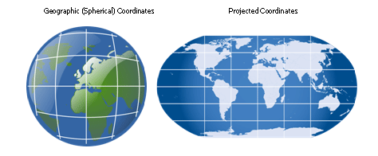
Coordinate systems provide the X-Y reference system to describe locations in two-dimensional space.

Slide 20
Compatible Coordinate Systems
Computerized data from different sources may have different coordinate systems and/or projections.
Fortunately, GIS software can usually convert to the matching projection and coordinate system – but watch out for this problem!
Our common projections: World Geodetic System (WGS-84) and North American Datums (NAD-1983)
NAD 1983 is tied to the North American and Pacific tectonic plates and WGS-1984 is not – plate movement means they are increasingly different!

Slide 21
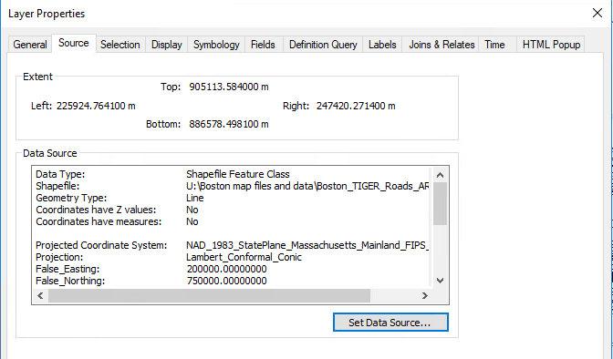
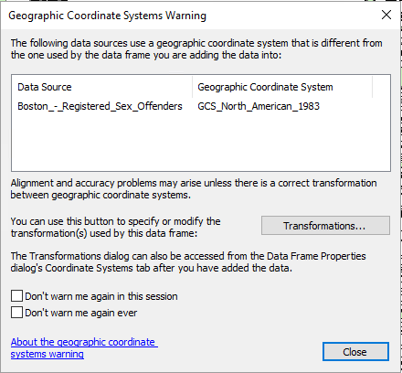

Slide 22
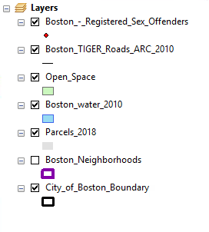
Traditional Elements of Maps
Common layers (biggest goes on bottom!):
Base layer of large area, e.g. country, state, county.
Smaller geographic units like counties, towns/cities, census tracts
Microgeographic areas like census tracts, block groups, blocks, parcels
Roads, transportation routes
Point features like crime incidents

Slide 23
Title
Key or Legend
Compass
or North Arrow
Creator

Slide 24
Pin Map
or
Point Map

Slide 25
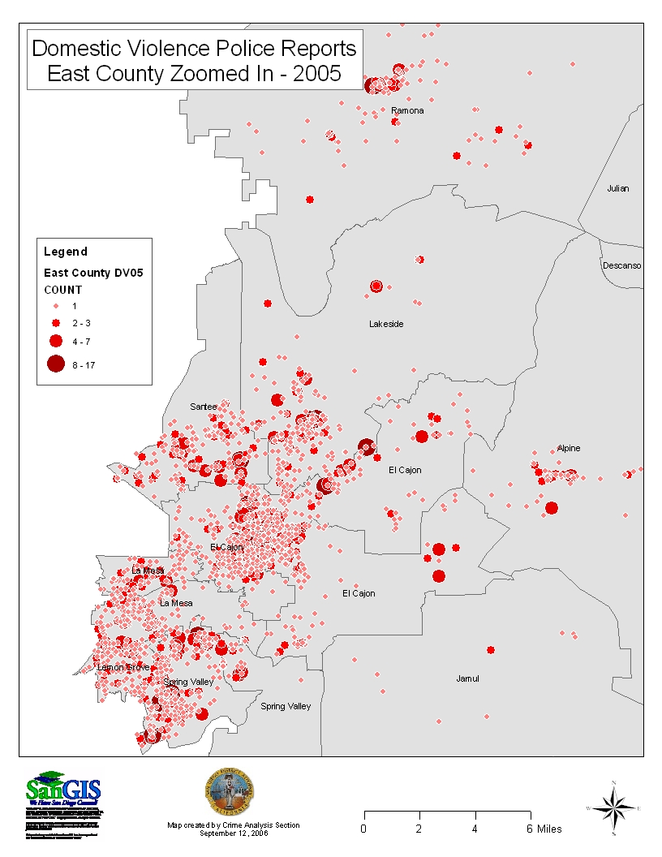
Graduated Point Map

Slide 26
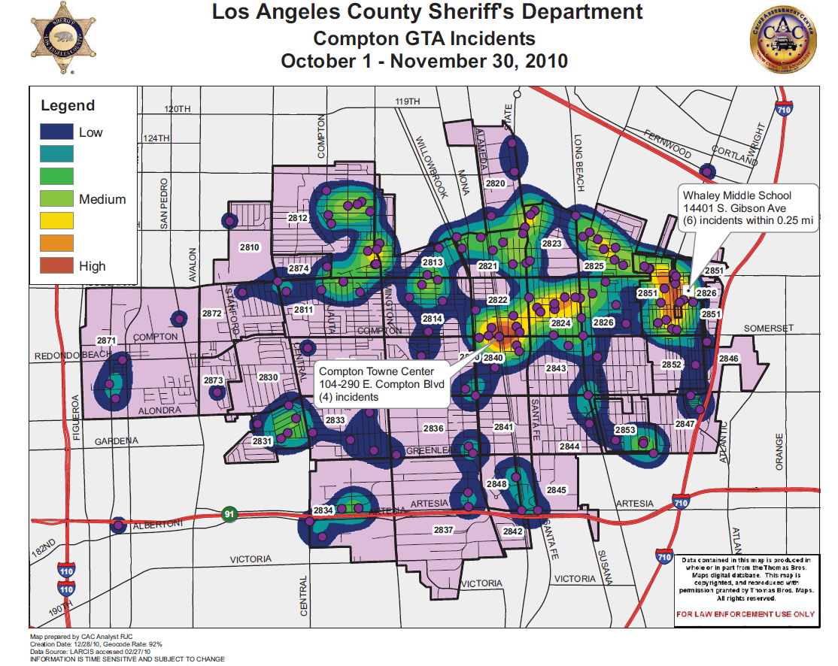
Density Map
or
Hot Spot Map

Slide 27
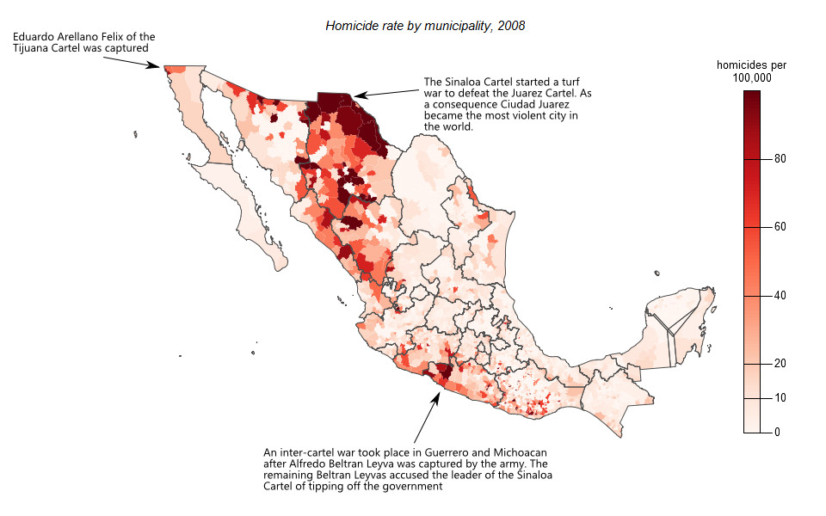
Choropleth
or
Shaded Grid Map

Slide 28
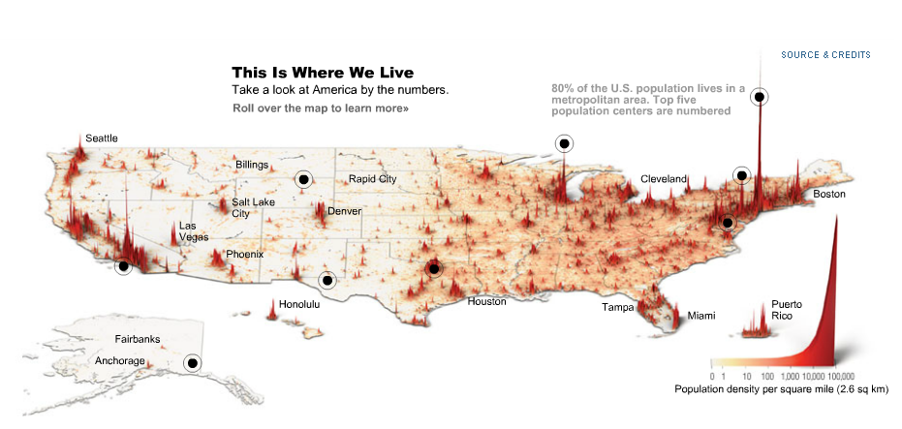
3D Choropleth Map (we’re not making this one!)

