Slide 1
Environmental Surveys and Direct Observation
Week 3, Day 2

Slide 2
Earlier this week…
Primary vs secondary data for crime analysis
Secondary data, e.g. data.boston.gov, Census, etc.
Primary data includes interviews, focus groups, environmental surveys and direct observations

Slide 3
What are environmental surveys?
They seek to systematically assess the overall physical environment of an area.
Can assist with regular scanning for problems, as well as analysis, response, and evaluation.
The physical environment is related to the social behavior of people in it.

Slide 4
Environmental surveys in practice
Example: Large-scale analysis of drug market hot spots
Documenting lighting, pedestrian and auto access routes, visibility, locations of public phones (it’s an old example), locations of bars and convenience stores, and places where people loiter.
Example: Comparing similar businesses or locations
Comparing features common to multiple separate locations – e.g. comparing many difference convenience stores to see why some stores are repeatedly robbed while others are not.

Slide 5
Direct observation
Environmental surveys can be paired with direct observation: observing a place for a certain amount of time to determine the social environment of the place.
How is the space used, what types of people are present, how do they congregate?

Slide 6
Environmental Survey and Direct Observation Design
In teams of 3, you will design your own written guide for an environmental survey and direct observation.
Use the provided examples as a model, but develop your own instrument.
Have elements of both environmental survey (physical environment) and direct observation (social environment).
Your survey should be 4-5 pages long and possible to implement.

Slide 7
Environmental Survey and Direct Observation Design
When your team has completed your survey design, choose a place to implement your survey.
You will each complete your own survey in the next week. Do not put yourselves in danger.
Write a 400-500 word description of the physical and social environment you observe in your setting and what this might mean for criminal activity there. Submit on Blackboard.

Slide 8
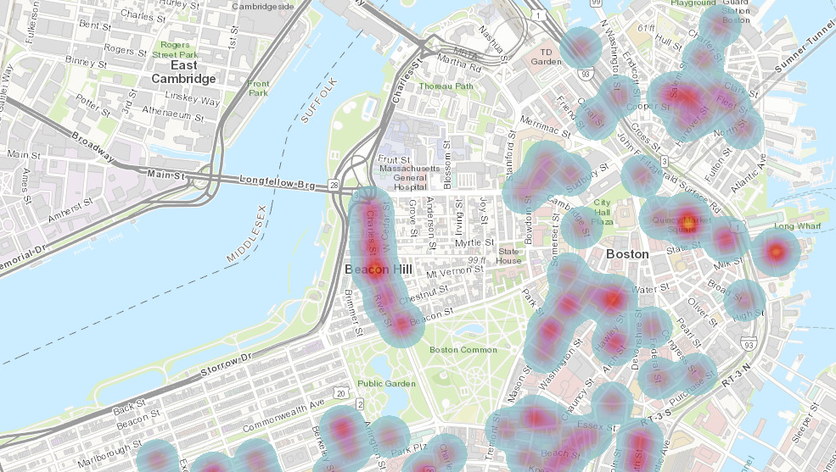
2018 Commercial Burglaries

