Slide 1
Crime Analysis Process and Data
Week 3, Day 1

Slide 2
AGENDA
Reminders
The crime analysis process
Types of crime analysis
Crime analysis data

Slide 3
The Scientific Process
Theories
Empirical Generalizations
Hypotheses
Data

Slide 4
The Crime Analysis Process
Data Collection
Feedback
Data collation
Dissemination of results
Data analysis

Slide 5
Data Collection
in,
out.

Slide 6
Data Collection
Data should be collected accurately and consistently.
Data should be timely.
Data should be accessible and safely stored.
Data should be relevant to the analysis.

Slide 7
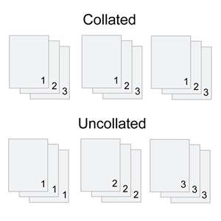
Data Collation
Ever seen this option when printing?
Collate: to assemble in proper order
Data collation includes cleaning, geocoding, and creating new variables.

Slide 8
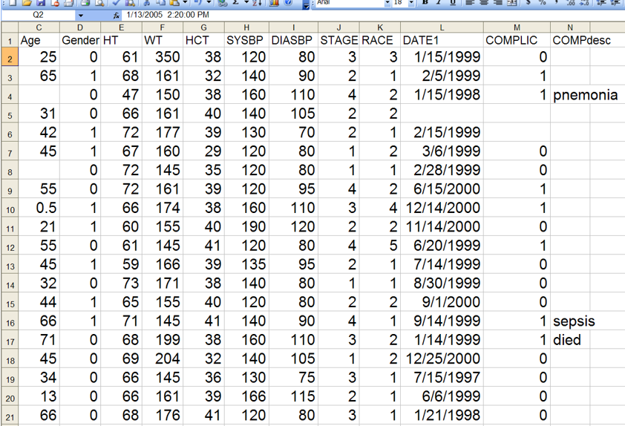
“I’d rather be grading.”
“Now we’re cooking with gas!”

Slide 9
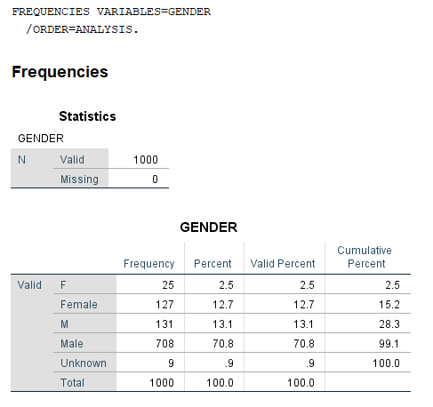
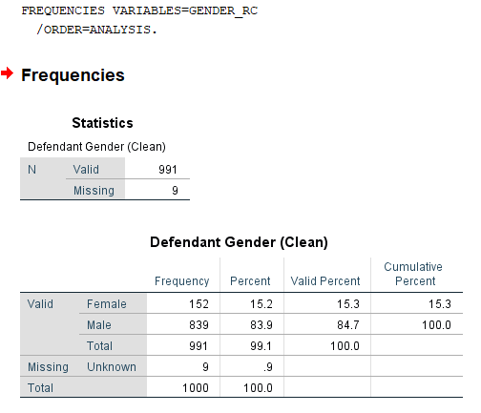

Slide 10
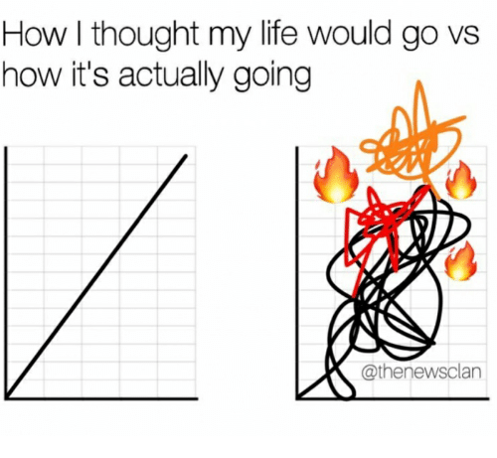
Data Analysis
Data analysis is rarely a linear process.
Problems may not appear until analysis begins.
Data collection and collation may need to be revised.

Slide 11
Dissemination of Results

Slide 12
Dissemination
You should tailor your dissemination strategies to your audience.
Academics? Journal articles and conference presentations.
Practitioners? Shorter reports made publicly accessible.
The general public? Highly visual, one-page summaries.

Slide 13
Feedback
Feedback helps to improve the crime analysis process.
Did your dissemination strategy get your product to your intended audience?
Did they get the necessary information?
Do they have additional questions?
What are the next steps?

Slide 14
Types of Crime Analysis
Tactical crime analysis
Strategic crime analysis
Operations analysis
Administrative analysis

Slide 15
Tactical Crime Analysis
The study of recent criminal incidents or series of incidents.
How, when, and where the activity occurred.
Short-term development of patrol and investigative priorities.

Slide 16
Strategic Crime Analysis
Analysis directed toward development and evaluation of long-term strategies for chronic problems.
Long-term statistical trends, hot spots, and problem analysis.
Like your final project!

Slide 17
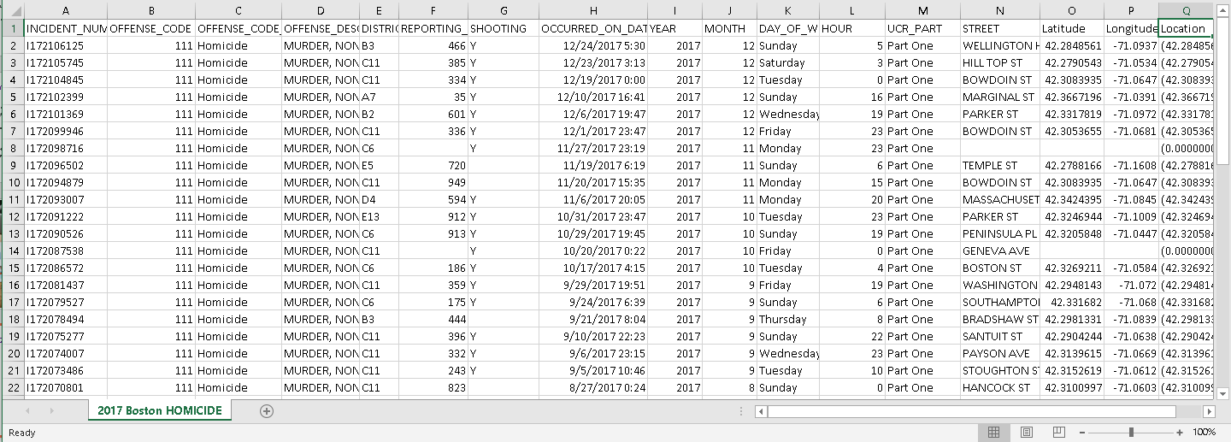
Crime Analysis Data

Slide 18
Primary vs. Secondary Data
Primary: Data collected specifically for the current analysis, e.g. going out and making your own observations, doing your own interviews.
Secondary: Data collected previously, often on an ongoing basis, for other purposes, e.g. administrative record-keeping of calls of service, crime incidents, government records.

Slide 19
Sources of Secondary Data
Crime incident data
Lists of incidents (like our crime data for projects)
Full crime reports (not as easy to access)
Type of crime, where, when
Only includes crimes known to police
Arrest data
Only includes crimes where an arrest was made
May include more information about the arrestee

Slide 20
Sources of Secondary Data
Calls for Service
One call, one record – could be multiple calls for one incident
Might not all be real/confirmed (“disposition”)
Location of call – may be inaccurate
Other databases
Persons known to police – known offenders, gang members
Property and vehicle databases
Sex offender registries

Slide 21
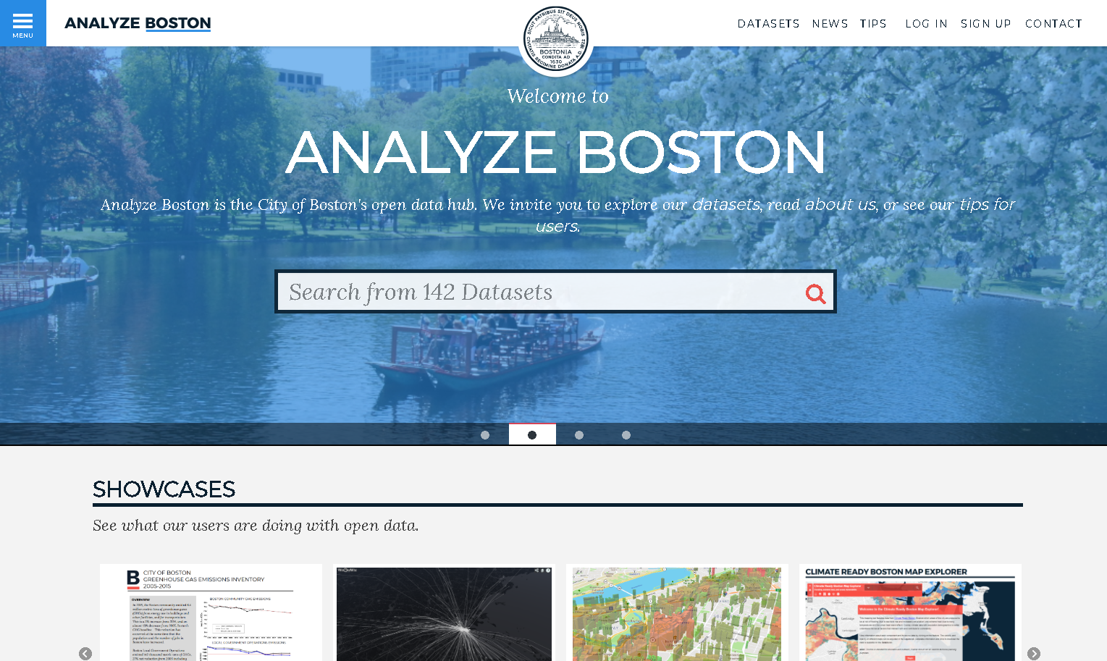

Slide 22
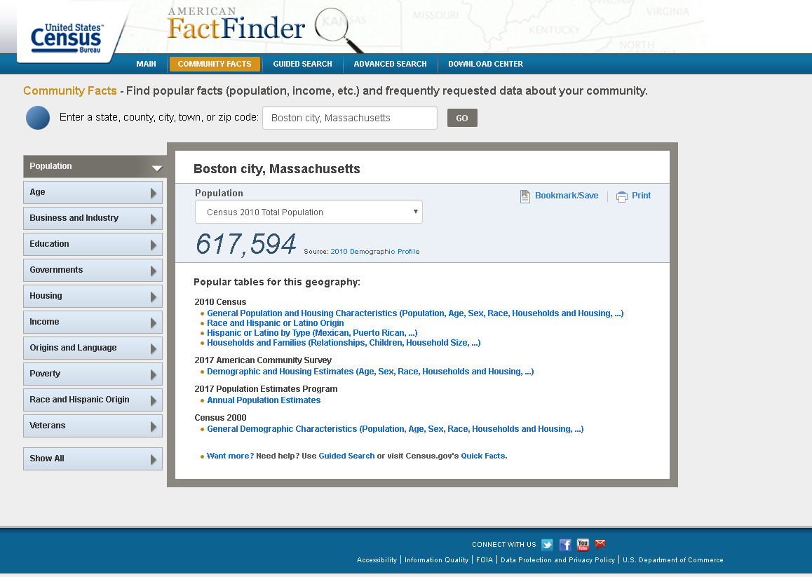

Slide 23
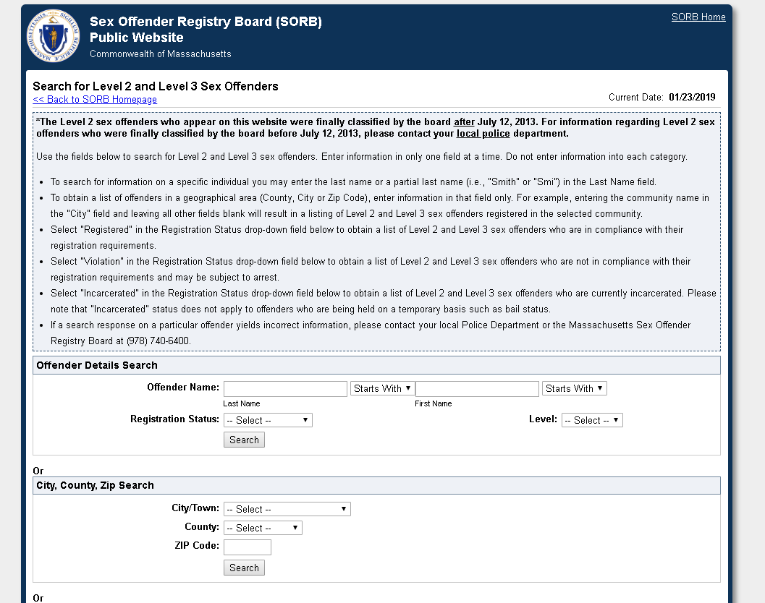

Slide 24
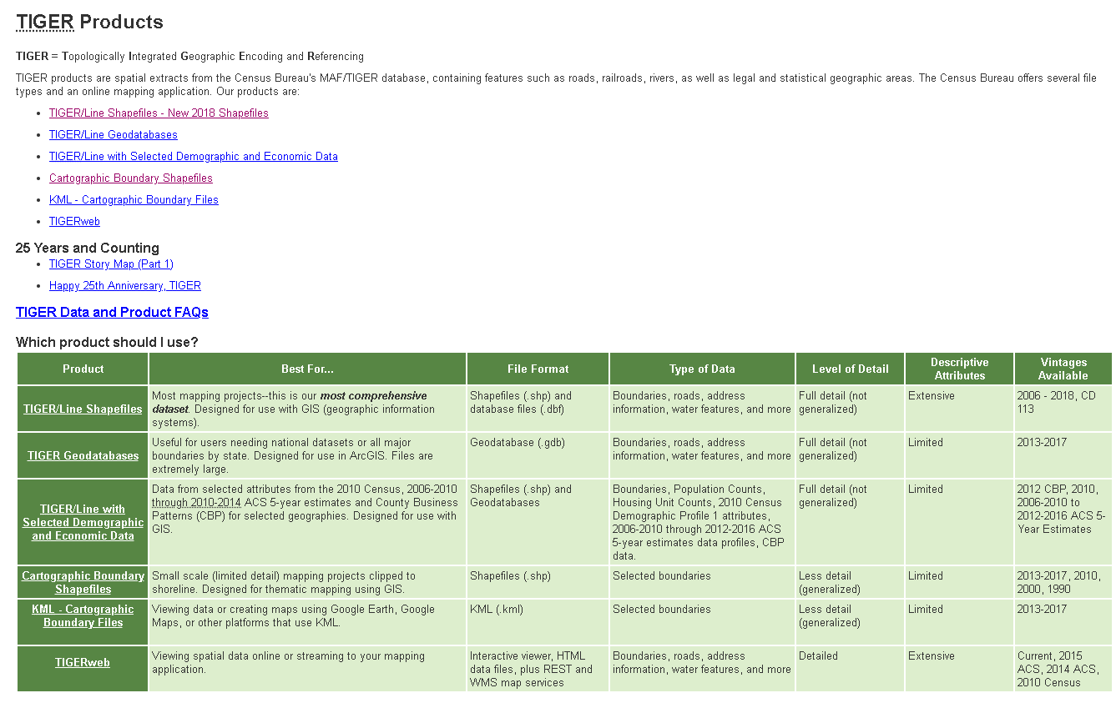

Slide 25
Collecting Primary Data
Interviews
Focus groups
Surveys
Environmental surveys and direct observation
Environmental survey: examining the physical features of a place
Direct observation: examining the social environment of a place -- who uses it, at what times, for which activities.

Slide 26
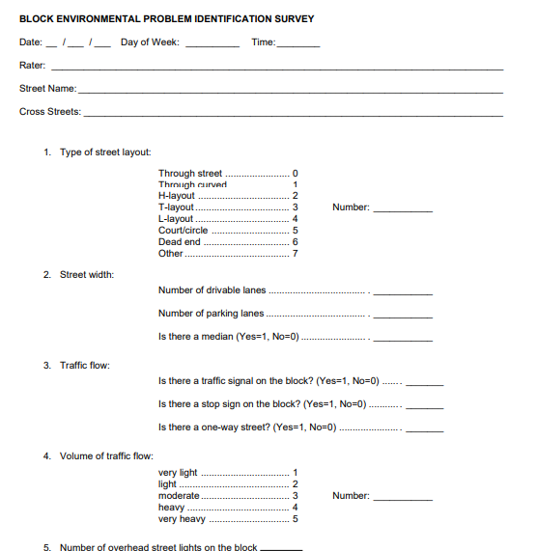
For next class…
Review the example environmental surveys on Blackboard.
Focus on what is asked/collected and how these tools help with systematic observation.

