Slide 1
The geometry of crime and Crime Pattern Theory
Crime Mapping
Week 2, Day 2

Slide 2
AGENDA
Reminders
The geometry of crime
Crime pattern theory
Exploring your activity space

Slide 3
The geometry of crime
Crimes do not occur randomly or uniformly in time or space or society – there are patterns.
Geometry of crime: the places in which we spend our time, and the pathways between them, are related to criminal offending and victimization.

Slide 4
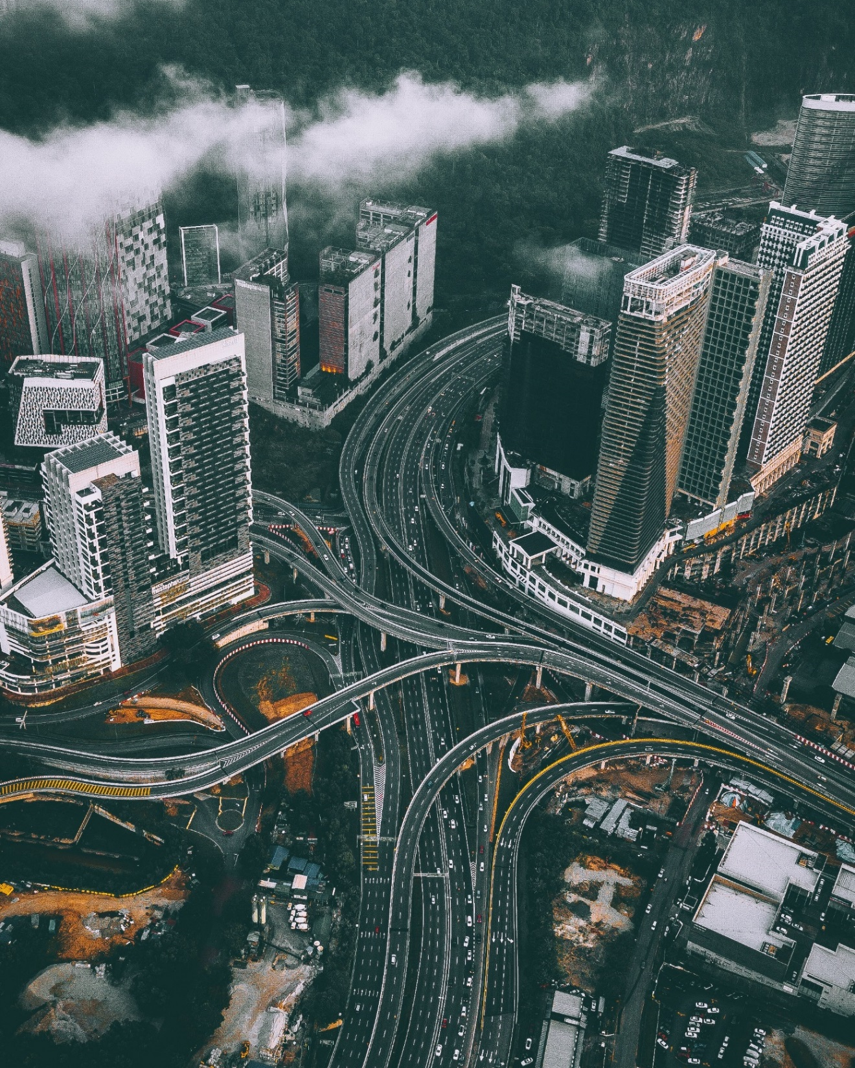
Crime Pattern Theory
Rule 1: The backcloth matters.
All of our activities play out across a backcloth composed of social, economic, political, and physical dimensions.
Our choices are shaped by social, political, and economic factors, as well as by the built environment.

Slide 5
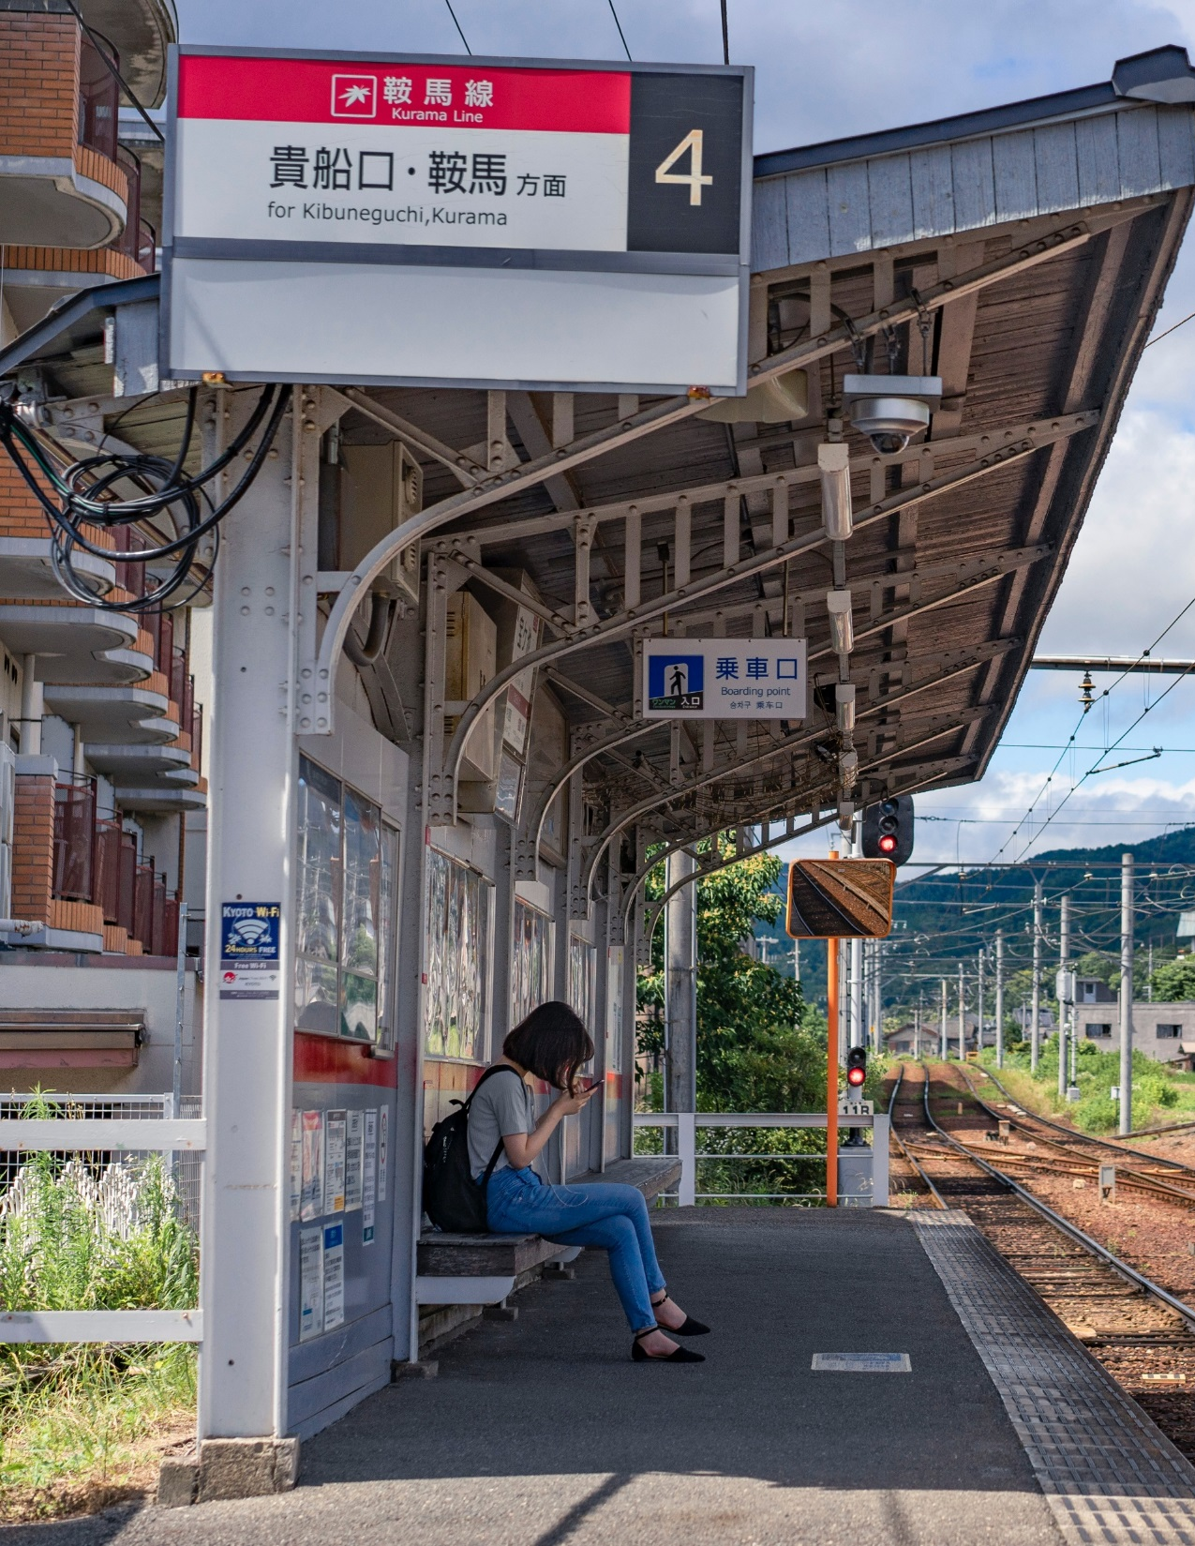
Rule 2: Upon the broader backcloth, individuals have a range of routine activities.
These occur in different nodes of activity, e.g. home, work, school, entertainment.
Nodes are connected by pathways – patterns of repetitive travel.

Slide 6
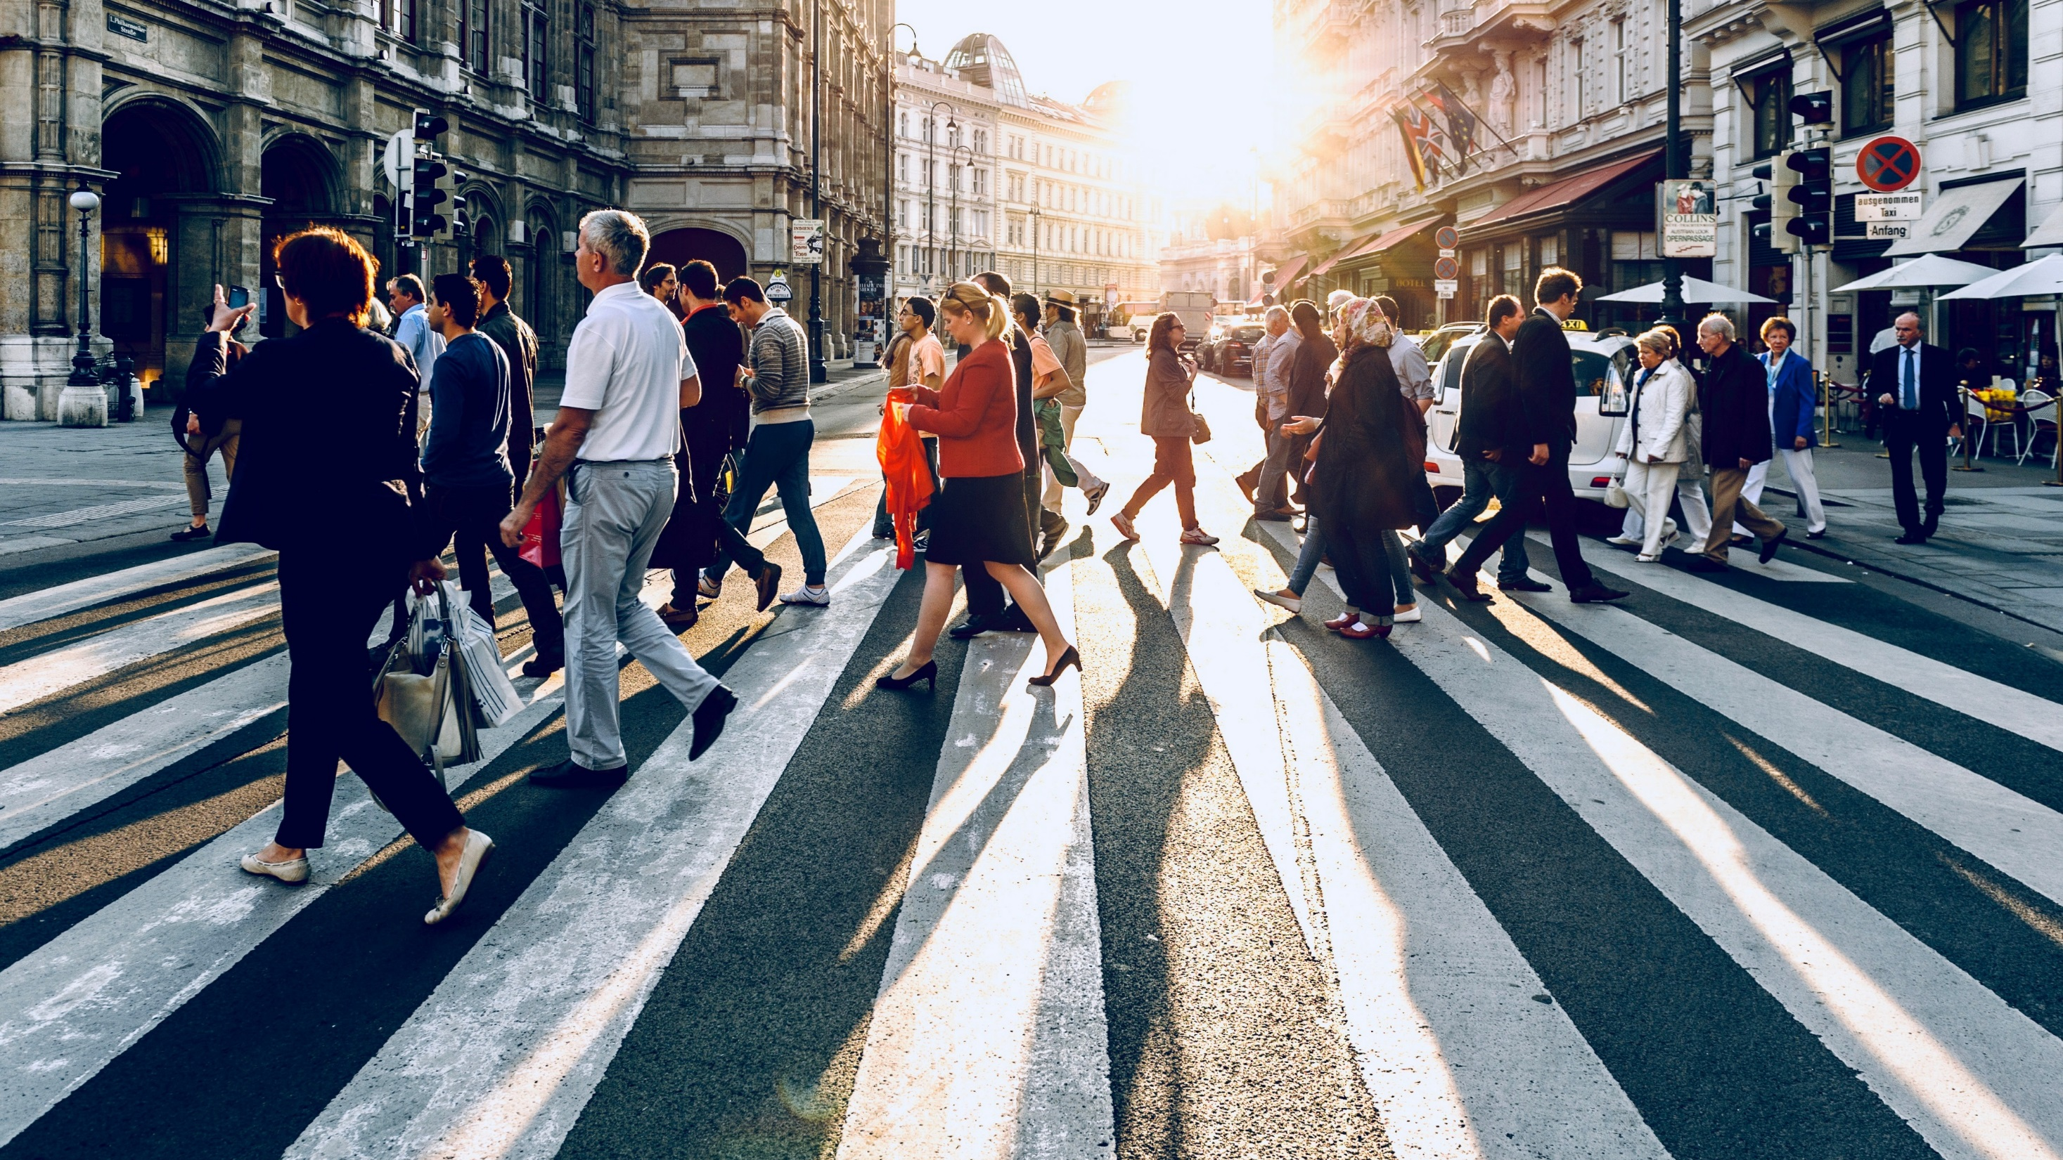
Rule 3: People who commit crimes have spatio-temporal movement patterns like everyone else. The likely location for crime is near this normal activity and awareness space.

Slide 7
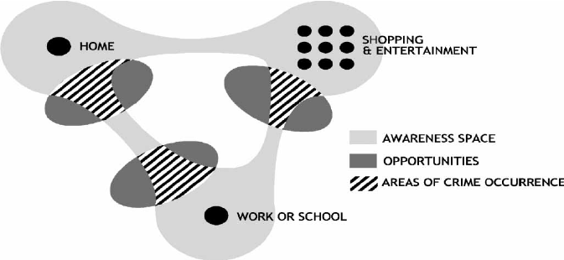
Cozens, P. (2008) New urbanism, crime and the suburbs: A review of the evidence. Urban Policy and Research, 26(4), 429-444.

Slide 8
Individual
Decisions
Decision template
Regularize decisions

Slide 9
Individual
Decisions
Decision template
As individuals move through activities, they make decisions.
Regularize decisions

Slide 10
Individual
Decisions
Decision template
When activities are repeated frequently, decisions become regularized.
Regularize decisions

Slide 11
Regularization creates an abstract guiding template, sometimes a crime template.
Individual
Decisions
Decision template
Regularize decisions

Slide 12
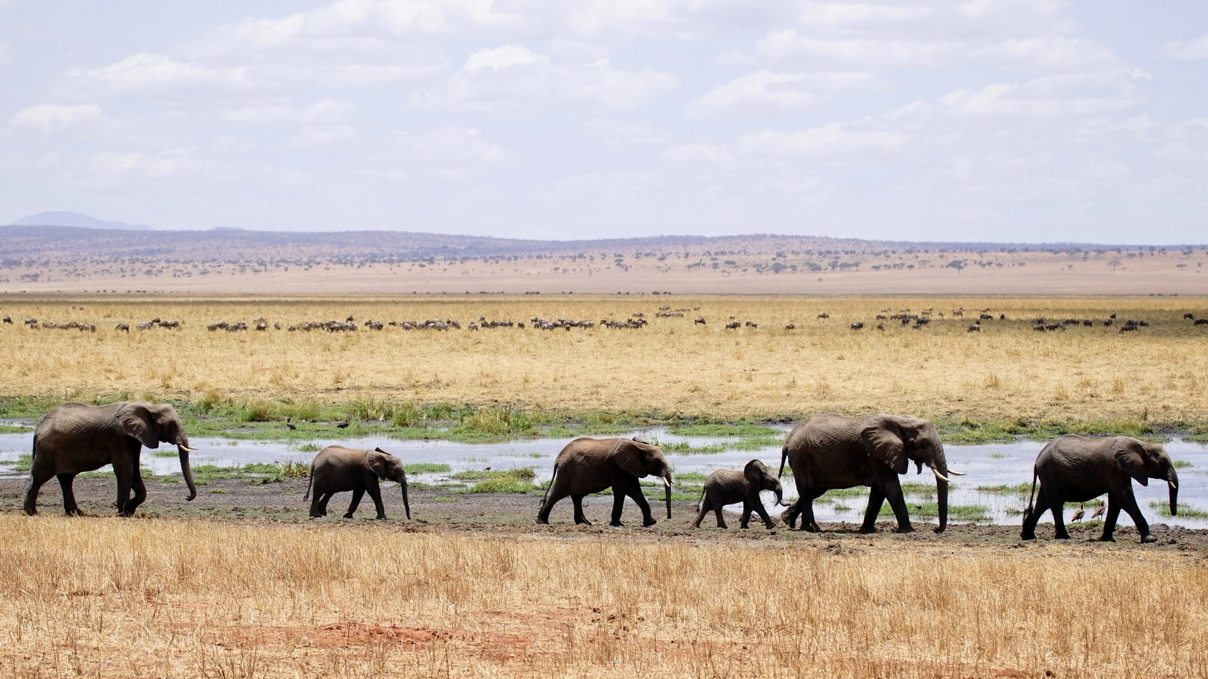
Rule 5: Most people do not function as individuals, but have a network of family, friends, and acquaintances. These linkages influence the decisions of others in the network.

Slide 13
Rule 6: Potential targets and victims have locations or activity spaces that intersect the activity spaces of potential offenders. Potential targets become actual targets if the offender is willing to offend and the target fits the offender’s crime template.

Slide 14
Rule 7:
Crime generators are created by high flows of people through and to nodal activity points.
Crime attractors are created when targets are located at nodal activity points of individuals who have a greater willingness to commit crimes.

Slide 15
Lots of people moving in/through, but not necessarily related to crime.
Rule 7:
Crime generators are created by high flows of people through and to nodal activity points.
Crime attractors are created when targets are located at nodal activity points of individuals who have a greater willingness to commit crimes.

Slide 16
Rule 7:
Crime generators are created by high flows of people through and to nodal activity points.
Crime attractors are created when targets are located at nodal activity points of individuals who have a greater willingness to commit crimes.
Places that create well-known opportunities for particular types of crime.

Slide 17
Individual:
(Non-) Routine activities
Triggering event
Crime attempted
Past experiences
Range of motivations
Range of opportunities
Success/failure
Rule 8: Individuals or networks of individuals commit crimes when there is a triggering event and a subsequent process by which an individual can locate a target or a victim that fits within a crime template.

Slide 18
Individual:
(Non-) Routine activities
Triggering event
Crime attempted
Past experiences
Range of motivations
Range of opportunities
Success/failure
Rule 9: The triggering event occurs when an individual is taking actions that are most often routine activities. The outcome of the criminal event impacts both the crime template and the routine activities. Criminal actions change the “bank” of accumulated experience and alter future actions.

Slide 19
Rule 10 (takes us back to Rule 1): The structural backcloth impacts both the routine activities of individuals and the decision to commit crime.

Slide 20
What is your activity space?
Create an illustration (e.g. in Paint or Powerpoint) of your awareness space, considering all primary activity nodes and pathways. Use thicker lines to represent pathways where you spend more time. How predictable are you?
What is your “backcloth” – what shapes your activity nodes and pathways? (Think sociologically! Who are you? What is your place?)
What opportunities for offending or victimization do you have on your pathways?

Slide 21
Cozens, P. (2008) New urbanism, crime and the suburbs: A review of the evidence. Urban Policy and Research, 26(4), 429-444.

Slide 22
Daycare
Shopping
Home:
Chelmsford
Entertainment:
Chelmsford & Nashua
Grocery stores
Lowell Station
Hobbies at home
Boston Common area
North Station
Cyberspace?
Work:
Downtown Boston
Suffolk campus

