Slide 1
Presenting Mapping Products
(briefly!)
Week 13, textbook chapter 15

Slide 2
Coming up:
Presentation slot sign-ups (5 minute slots)
All presentations due by email to Dr. Stone by 8am Tuesday.
Written projects due on Blackboard by end of day April 30th.
Today: Inserting maps and graphs into Microsoft Office documents; final project checklist, finishing up project components.

Slide 3
Putting maps in your presentations
Maps exported as .jpg files can simply be added to your presentations as an image.
Make sure that you size them appropriately!
How will you show off your skills & make your presentation special?
If you want to highlight certain areas, it might make sense to show a more zoomed-in map – for example…

Slide 4
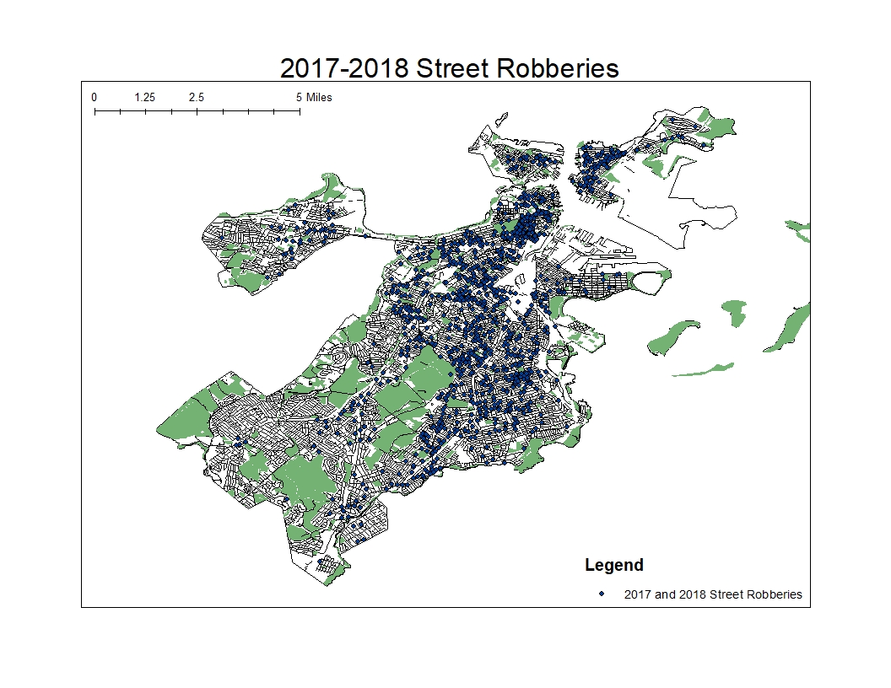

Slide 5
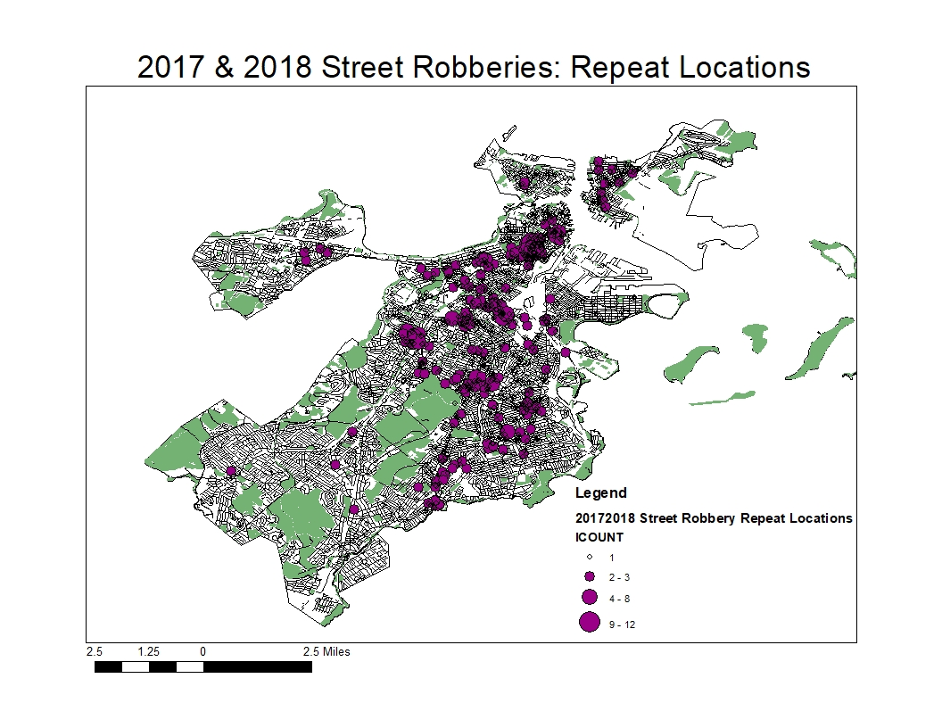

Slide 6
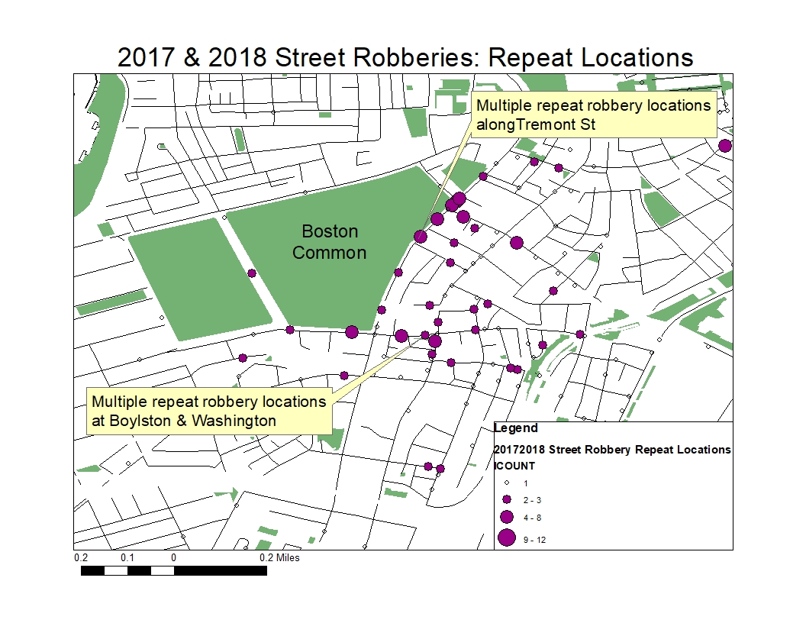

Slide 7
Putting graphs in your presentations
Simply copy and paste the graph from your Excel spreadsheet into your Powerpoint slide.
Make sure your title and axis labels are correct and there are no extra data series showing.
Make sure your map is big enough for your audience to see. You can adjust font size in Powerpoint.
What will you say about your graphs? What do they show?

Slide 9
Robberies were most unlikely to occur between 5am and 11am.

Slide 10
Peak time for robberies was between 8pm and 2am.

Slide 11
Putting maps and graphs in reports
You can paste graphs and your .jpg maps into Word documents, too.
Again, make sure everything is sized appropriately and is legible.
For maps, you may want to make one page “landscape” to feature a large map and then refer to it in your text (e.g. “See Map 1, next page”).
I recommend one half or one full page for maps, and one-third to one-half a page for graphs.

Slide 12
Final project checklist
Remember, the checklist represents the minimum requirements.
How will you set your project apart?
Additional maps or graphs?
Special mapping techniques?
Thorough analysis of your data?
Innovative strategies?

Slide 13
Presentations:
Introduce crime type
Show results of your analysis (2 map, 2 graphs)
Share your recommended strategies based on your analysis
5 minutes max – make sure you practice so you know you can cover your information without going over time!

Slide 14
Papers:
Introduction to your crime/disorder problem
Literature review: What do we know about this problem? Cite sources!
Methods: Where are your data from? What did you have to do to them to be able to produce your results?
Results: At least two different maps and two different graphs, with written description of what they tell you about your crime
Strategy/Recommendations: Definitely cite sources here
Works Cited/References

