Slide 1
Strategy Development
Situational Crime Prevention & CPTED
Week 12

Slide 2
The role of police has expanded.
Enforce law
Fight crime
Apprehend criminals

Slide 3
Manage traffic
Enforce regulations
Distribute
official records
Settle disputes
Enforce law
Fight crime
Apprehend criminals
Public
outreach
& training
Maintain peace
Care for vulnerable
Counterterrorism

Slide 4
To prevent and control conduct widely recognized as threatening to life and property (serious crime).
To aid individuals who are in danger of physical harm, such as the victim of a criminal attack
To protect constitutional guarantees, such as the right of free speech and assembly
To facilitate the movement of people and vehicles

Slide 5
To assist those who cannot care for themselves: the intoxicated, the addicted, the mentally ill, the physically disabled, the old and the young.
To resolve conflict, whether it be between individuals, groups of individuals, or individuals and their government.
To identify problems that have the potential for becoming more serious problems
To create and maintain a feeling of security in the community.

Slide 6
Traditional policing strategies
Random preventive patrol
Rapid response
Follow-up investigations

Slide 7
Traditional policing strategies
Random preventive patrol: Neither controls crime nor makes citizens feel safer
Rapid response: Only works in very small proportion of incidents
Follow-up investigations: Not as effective as believed

Slide 8
“Problem-Oriented Policing” (POP)
“Microscopic evaluation” of a problem
Not dependent on CJ system; engaging other agencies, community, private sector
Discovering new & more effective (preventive) strategy
Implementing the new strategy, evaluating effectiveness
Reporting results & building body of knowledge

Slide 9
Microscopic examination of problems draws on principles and methods of social science.

Slide 10
POP places high value on new responses that are:
Preventive in nature
Not dependent on the criminal justice system
That engage other public agencies, the community, and the private sector

Slide 11
Implementing, evaluating, and disseminating

Slide 12
The role of crime analysts is expanding.
“If crime analysts have one collective shortcoming, it is that they do not participate sufficiently in turning their analyses into action. It is not enough to deliver the report.
Crime analysts should be expert consultants not only on what, but also on what to do about it.”
Police Chief Tom Casady,
Exploring Crime Analysis (IACA, 2008)

Slide 13
Tactics to intervene in a series
Remove the motivated offender through apprehension tactics
Remove the suitable target through target hardening tactics
Supply the capable guardianship through suppression tactics

Slide 14
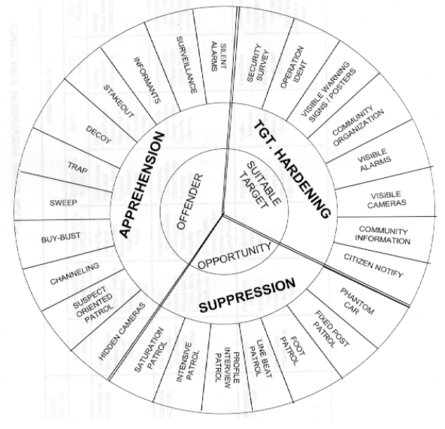

Slide 15
What does this remind you of?
(Remember: to seize an opportunity, you have to be in the right _________ at the right _______.

Slide 16
Apprehension tactics focus on apprehending the offender(s).
Stakeouts, decoys, traps, buy-bust, sweeps, hidden cameras, informants, surveillance, silent alarms.

Slide 17
Target-hardening tactics focus on securing the victim/target.
Warning signs, community organization, visible/audible alarms, visible cameras, community information, notifying citizens.

Slide 18
Suppression tactics focus on increasing guardianship.
Increasing visibility of law enforcement through various types of patrol..

Slide 19
Strategies for long-term problems
Increase Effort | Increase Risk | Reduce Reward | Reduce Provocation | Remove Excuses
Harden targets | Extend guardianship | Conceal targets | Reduce frustration/stress | Set rules
Control access | Assist natural surveillance | Remove targets | Avoid disputes | Post instructions
Screen exits | Reduce anonymity | Identify property | Reduce arousal | Alert conscience
Deflect offenders | Utilize place managers | Disrupt markets | Neutralize peer pressure | Assist compliance
Control tools and weapons | Strengthen formal surveillance | Deny benefits | Discourage imitation | Control drugs/alcohol

Slide 20
Crime Prevention Through Environmental Design
Crime…
… requires a suitable target, a likely offender, and the absence of a capable guardian
… is committed by offenders as they go about their daily activities (in their activity space)
… is committed by offenders who seek to minimize risk and maximize reward…

Slide 21
C.P.T.E.D.
“The design, manipulation, and management of the build environment to reduce crime and the fear of crime and to enhance sustainability through the process and application of measures at the micro (individual building/structure), meso (neighborhood), and macro (national) level.”
Armitage, 2016

Slide 22
C.P.T.E.D.
Defensible space and territoriality
Limiting through movement
Surveillance
Physical security
Management and maintenance

Slide 23
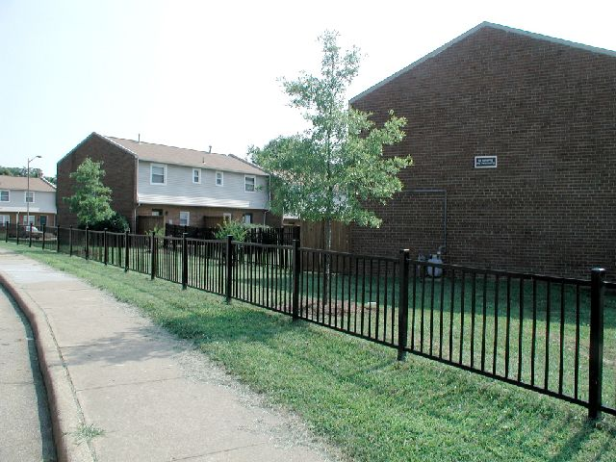
Defensible space and territoriality
Photo credit: Russell James, Texas Tech, CPTED (Crime Prevention Through Environmental Design)
https://www.slideshare.net/rnja8c/cpted-crime-prevention-through-environmental-design-4686167

Slide 24
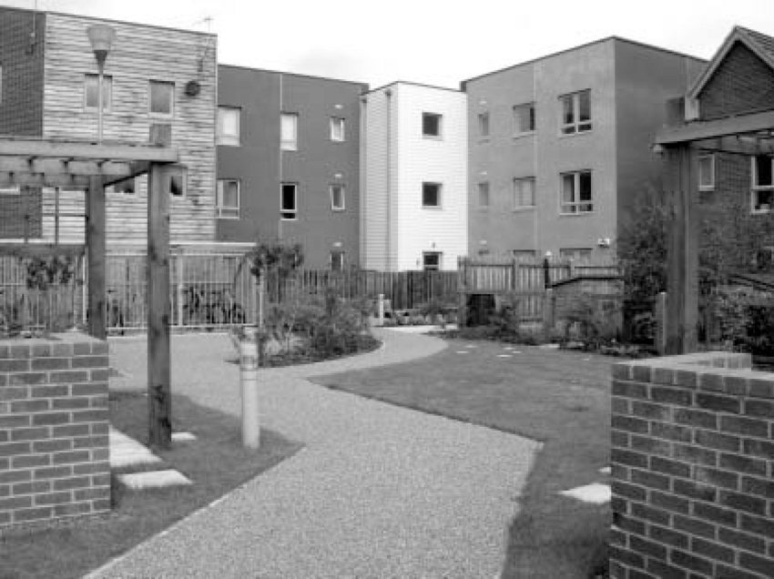
Limiting through movement
Balancing the benefit of limiting access (for security) and the benefit of encouraging walking and cycling (increasing sustainability and prosocial use of space – also increases guardianship).

Slide 25
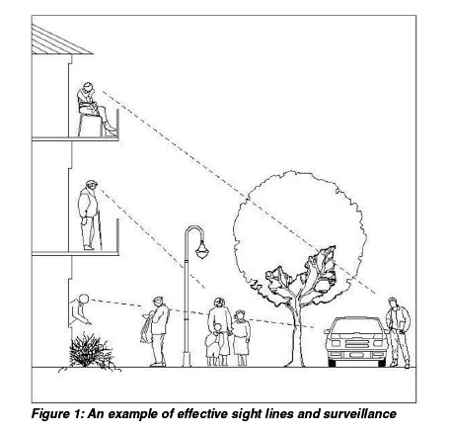
Surveillance

Slide 27
Physical Security

Slide 28
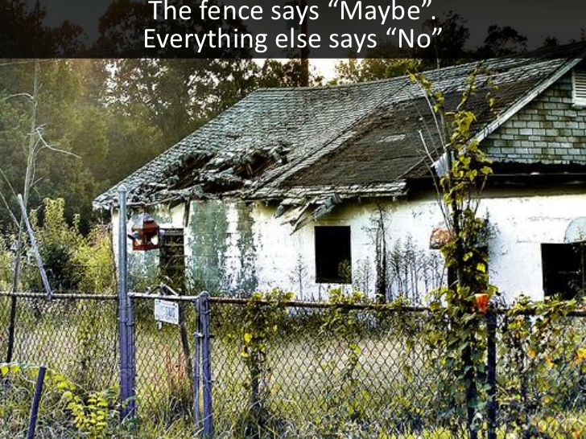
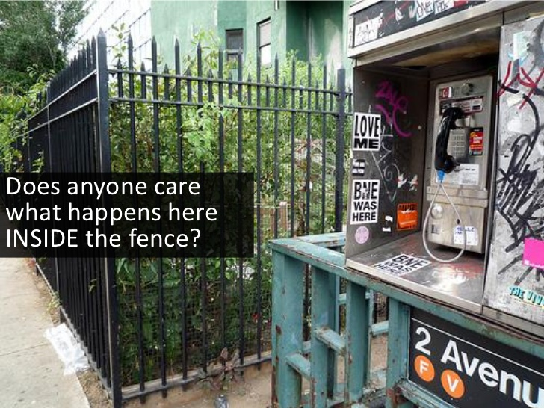
Management and Maintenance

Slide 29
