Slide 1
Tactical Crime Analysis
Textbook Ch. 8 – 11
Week 10

Slide 2
Topics covered…
Ch. 8: Repeat Incidents and Tactical Data Collections
Ch. 9: Pattern Identification Process
Ch. 10: Identifying Meaningful and Useful Patterns
Ch. 11: Describing and Disseminating Known Patterns

Slide 3
Tactical Crime Analysis
The study of recent criminal incidents or series of incidents.
How, when, and where the activity occurred.
Short-term development of patrol and investigative priorities.

Slide 4
Pattern Identification
The first goal of tactical crime analysis is pattern identification
Linking crimes by type, modus operandi (MO), person and vehicle characteristics, etc.
MO: the method of the crime (type of crime, how it was committed, where, and when)
Repeat Incidents: cluster of two or more incidents similar in nature, in same place or by same person(s)

Slide 5
Pattern Identification: Data
Crime incident data: calls-for-service or incident reports.
May be repeated calls to same address/for same person, for similar complaints
MO: type of crime, point and method of entry, actions taken, weapon type, property taken, type of location, area, time of day

Slide 6
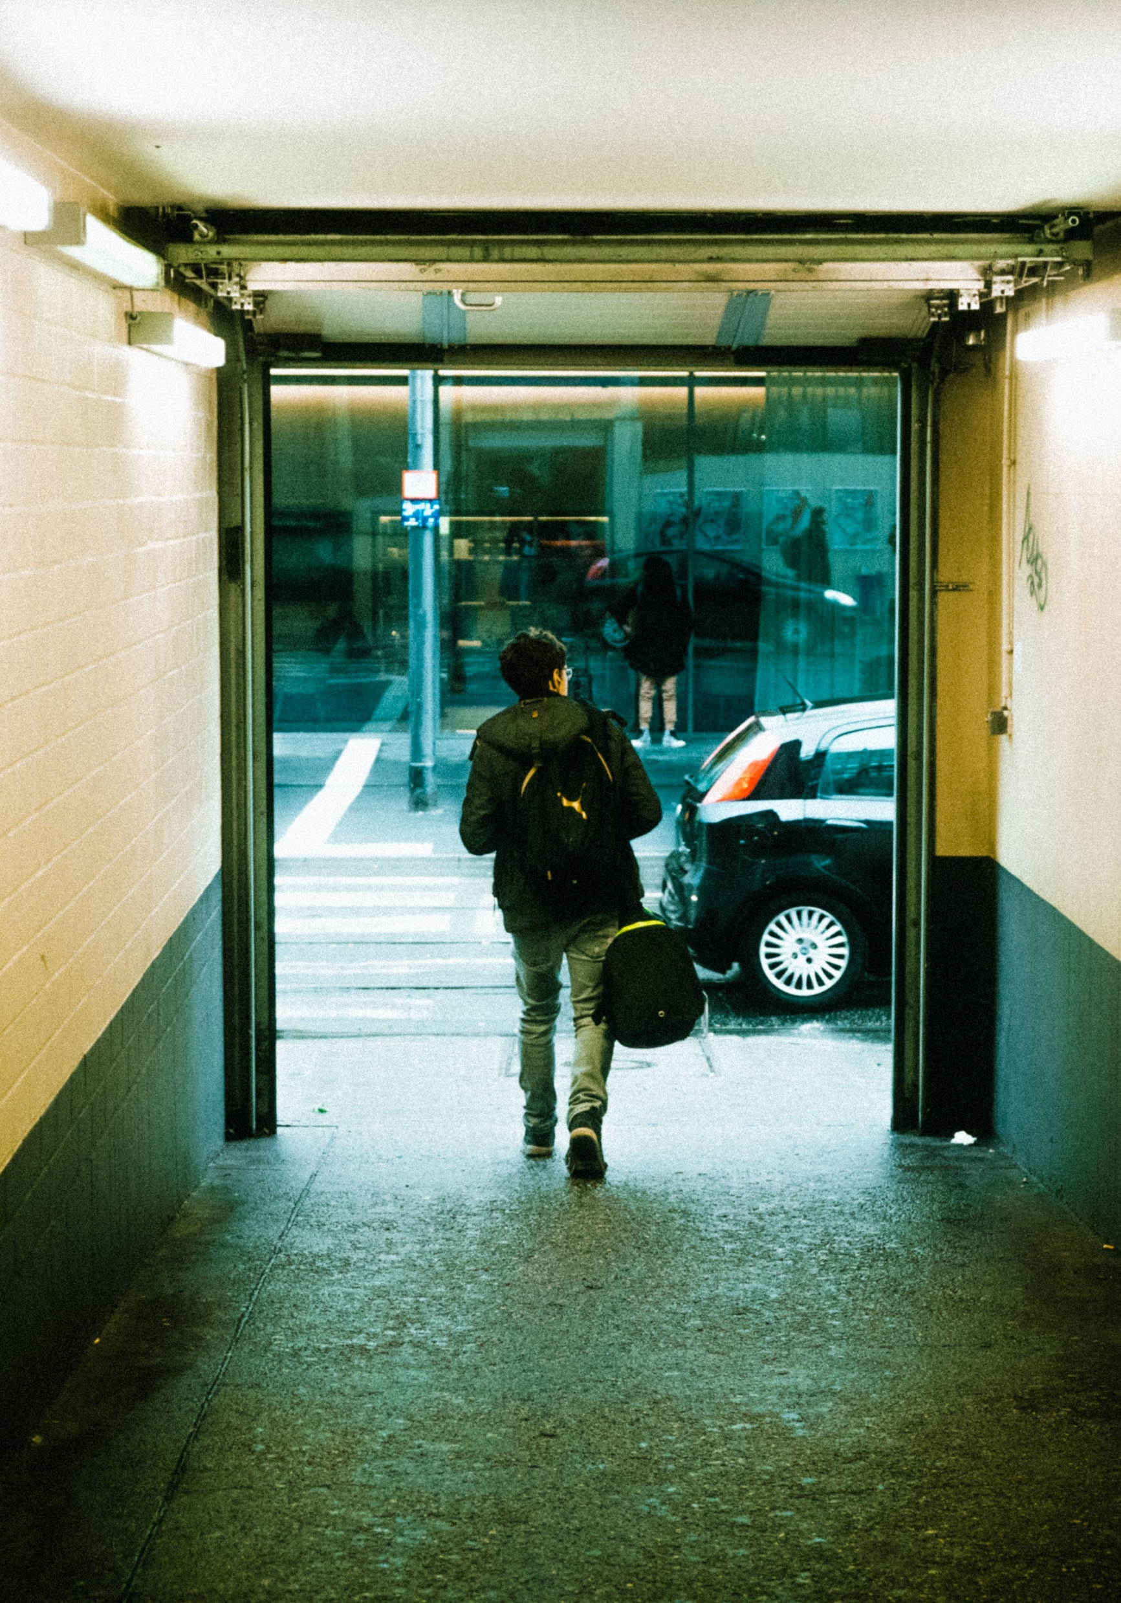
Pattern Identification: Data
Person data: description and condition of the person involved (not their actions – that’s part of MO)
Lead, suspect, known offender, victim, or witness?
Description: static physical characteristics, e.g. race, height
Condition: characteristics that may change quickly, e.g. hair color/length, grooming.

Slide 7
Pattern Identification: Data
Vehicle data:
Official information: VIN,
plate #, state of issue
Physical description: Make, model, style, color
Condition of vehicle: After- market modifications, damage, deterioration

Slide 8
HOT PREY
HOT SPOT
SERIES
SPREE
HOT SETTING
HOT PLACE
HOT PRODUCT

Slide 9
A group of similar crimes thought to be committed by the same individual(s)
HOT PREY
HOT SPOT
SPREE
HOT SETTING
HOT PLACE
HOT PRODUCT

Slide 10
A type of series, high frequency of activity within short time frame
HOT PREY
HOT SPOT
SERIES
HOT SETTING
HOT PLACE
HOT PRODUCT

Slide 11
Group of crimes (same or different offenders) involving similar victims
HOT SPOT
SERIES
SPREE
HOT SETTING
HOT PLACE
HOT PRODUCT

Slide 12
Group of crimes (same or different offenders) within close proximity
HOT PREY
SERIES
SPREE
HOT SETTING
HOT PLACE
HOT PRODUCT

Slide 13
HOT PREY
HOT SPOT
SERIES
SPREE
Group of crimes occurring in same type of place, e.g. convenience stores
HOT PLACE
HOT PRODUCT

Slide 14
HOT PREY
HOT SPOT
SERIES
SPREE
Group of similar crimes committed at the same location, e.g. one movie theater
HOT SETTING
HOT PRODUCT

Slide 15
HOT PREY
HOT SPOT
SERIES
SPREE
Group of crimes targeting a specific type of property, e.g. car GPSs
HOT SETTING
HOT PLACE

Slide 16
Person and Property Crime Patterns
Persons crimes: crimes where people are the targets
Assault, homicide, robbery, sexual assault (inc. indecent exposure), etc.
Property crimes: crimes where property/objects are the targets
Theft from a vehicle, auto theft, residential and commercial burglary, etc.

Slide 17
Potential Responses to Short-Term Problems
Directed patrol
Field contacts
Surveillance
Sting/bait operations
Investigation across cases in pattern
Contacting victims
Providing information to public

Slide 18
Time-of-Day and Day-of-Week Analysis
Creating graphs of crime series data to quickly determine which hours of the day and which days of the week are the most likely for crime
(Can also be performed for strategic analysis of long-term crime problems, using much more data!)
Two graphs of this type must be included in your final project!

